Slide 1
Oracle Database 10g: SQL
Fundamentals I
Electronic Presentation
D17108GC11
Production 1.1
August 2004
D39769
®

Slide 2
SQL
Statements
SELECT INSERT
DELETE MERGE
CREATE ALTER
^{DROP} Data definition language (DDL)
TRUNCATE COMMENT
^{GRANT} Data control language (DCL)
COMMIT
ROLLBACK Transaction control
SAVEPOINT
UPDATE Data manipulation language (DML)
RENAME
REVOKE
Copyright © 2004, Oracle. All rights reserved.

Slide 3
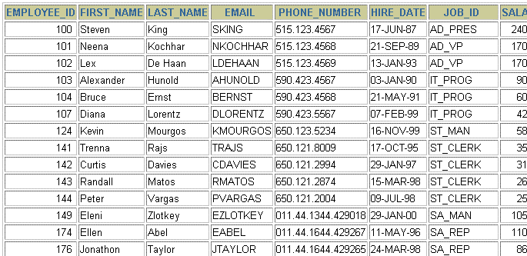
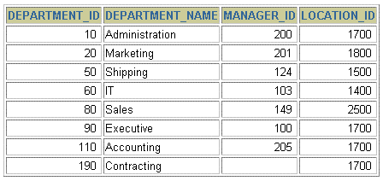
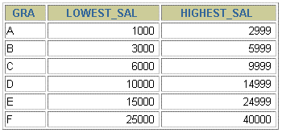
Tables
Used
in
the
Course
EMPLOYEES
DEPARTMENTS
JOB_GRADES
Copyright © 2004, Oracle.
All rights reserved.

Slide 4
Retrieving Data Using
the
SQL SELECT
Statement
Copyright © 2004, Oracle. All rights reserved.

Slide 5
Objectives
After completing this lesson, you should be able to
do
the
•
•
•
following:
List the capabilities of SQL SELECT statements
Execute a basic SELECT statement
Differentiate between SQL
statements
and
iSQL*Plus
commands
Copyright © 2004, Oracle.
All rights reserved.

Slide 6
Capabilities
of
SQL
SELECT Statements
Projection
Selection
Table
1
Table
1
Join
Table
1
Table
2
Copyright © 2004, Oracle. All rights reserved.

Slide 7
Basic SELECT Statement
SELECT *|{[DISTINCT] column|expression [alias],...}
FROM table;
•
•
SELECT identifies the columns to be displayed
FROM identifies
the
table
containing
those
columns
Copyright © 2004, Oracle. All rights reserved.

Slide 8
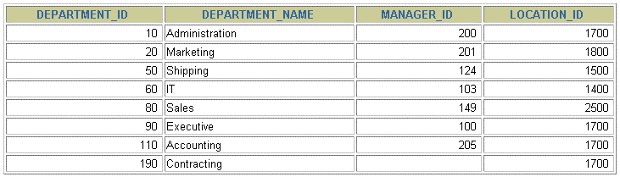
Selecting
All
Columns
SELECT *
FROM departments;
Copyright © 2004, Oracle.
All rights reserved.

Slide 9
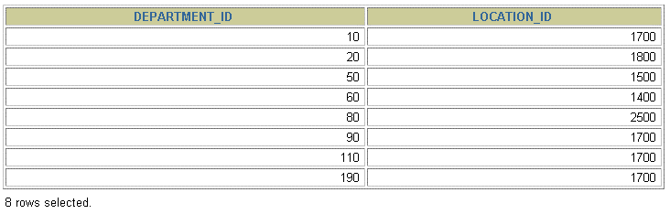
Selecting
Specific
Columns
SELECT department_id, location_id
FROM departments;
Copyright © 2004, Oracle. All rights reserved.

Slide 10
Writing SQL Statements
•
•
•
SQL statements are not case-sensitive.
SQL statements can be on one or more lines.
Keywords cannot be abbreviated or split
across lines.
Clauses are usually placed on separate lines.
Indents are used to enhance readability.
•
•
•
•
Copyright © 2004, Oracle. All rights reserved.

Slide 11
Arithmetic Expressions
Create expressions with number
and
date
data
by
using
arithmetic
operators.
Operator
Description
+
Add
-
Subtract
*
Multiply
/
Divide
Copyright © 2004, Oracle.
All rights reserved.

Slide 12
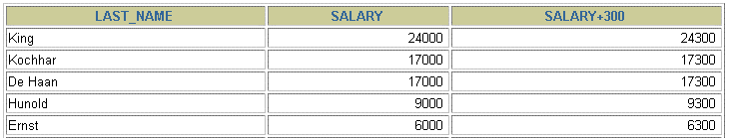
Using
Arithmetic
Operators
SELECT last_name, salary, salary + 300
FROM employees;
…
Copyright © 2004, Oracle. All rights reserved.

Slide 13


Operator
Precedence
SELECT last_name, salary, 12*salary+100
1
FROM
employees;
…
SELECT last_name, salary, 12*(salary+100) ₂
FROM
employees;
…
Copyright © 2004, Oracle.
All rights reserved.

Slide 14
Defining a Null Value
•
A null is a value that is unavailable, unassigned,
unknown, or inapplicable.
•
A
null
is
not
the
same
as
a
zero
or
a
blank
space.
SELECT last_name, job_id, salary, commission_pct
FROM employees;
…
…
Copyright © 2004, Oracle. All rights reserved.

Slide 15
Null Values
in Arithmetic Expressions
Arithmetic expressions
containing
a
null
value
evaluate
to
null.
SELECT last_name, 12*salary*commission_pct
FROM employees;
…
…
Copyright © 2004, Oracle. All rights reserved.

Slide 16
Defining a Column
Alias
A
•
•
•
column alias:
Renames a column heading Is
useful with calculations
Immediately follows the column
also be the optional AS keyword
column name and alias.)
name (There
between the
can
•
Requires double quotation marks if it contains
spaces or
sensitive
special characters or if it
is
case-
Copyright © 2004, Oracle. All rights reserved.

Slide 17


Using
Column
Aliases
SELECT last_name AS name, commission_pct comm
FROM employees;
…
SELECT last_name "Name" , salary*12 "Annual Salary"
FROM employees;
…
Copyright © 2004, Oracle. All rights reserved.

Slide 18

Concatenation Operator
A
•
concatenation operator:
Links columns or character strings to other columns
Is represented by two vertical bars (||)
•
•
Creates a resultant
expression
column
that
is
a
character
SELECT last_name||job_id AS "Employees"
FROM employees;
…
Copyright © 2004, Oracle. All rights reserved.

Slide 19
Literal Character Strings
•
A literal is a character, a number, or a date that is
included in the SELECT statement.
Date and character literal values must be enclosed by single quotation marks.
•
•
Each character
string
is
output
once
for
each
row
returned.
Copyright © 2004, Oracle.
All rights reserved.

Slide 20
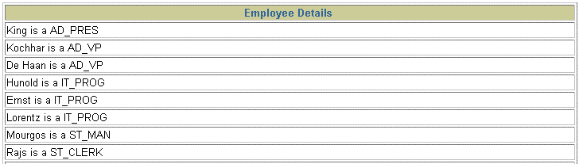
Using
Literal
Character
Strings
SELECT last_name ||' is a '||job_id
AS "Employee Details"
FROM employees;
…
Copyright © 2004, Oracle. All rights reserved.

Slide 21


Duplicate
Rows
The default display
duplicate rows.
of
queries
is
all
rows,
including
SELECT department_id ₁
FROM
employees;
…
SELECT DISTINCT department_id
2
FROM
employees;
…
Copyright © 2004, Oracle.
All rights reserved.

Slide 22
Displaying Table Structure
Use the iSQL*Plus DESCRIBE command
to
display
the
structure
of
a
table:
DESC[RIBE] tablename
Copyright © 2004, Oracle.
All rights reserved.

Slide 23
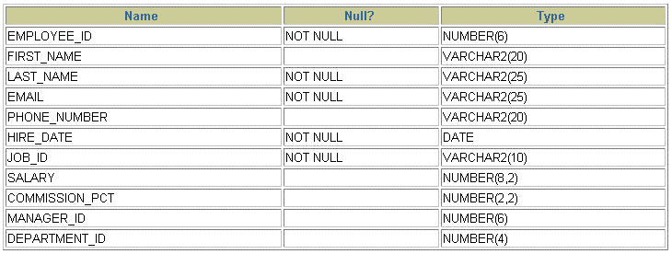
Displaying
Table
Structure
DESCRIBE employees
Copyright © 2004, Oracle. All rights reserved.

Slide 24
Summary
In
•
this lesson, you should have learned
Write a SELECT statement that:
how to:
–
–
–
Returns all rows and columns from a table
Returns specified columns from a table
Uses column aliases to display more descriptive column headings
•
SELECT *|{[DISTINCT] column|expression [alias],...}
FROM table;
Copyright © 2004, Oracle. All rights reserved.

Slide 25
Restricting
and
Sorting
Data
Copyright © 2004, Oracle.
All rights reserved.

Slide 26
Objectives
After completing this lesson, you should be able
to
do
the
•
•
•
following:
Limit the rows that are retrieved by a query
Sort the rows that are retrieved by a query
Use ampersand substitution in iSQL*Plus
to
restrict
and sort
output
at
run
time
Copyright © 2004, Oracle. All rights reserved.

Slide 27
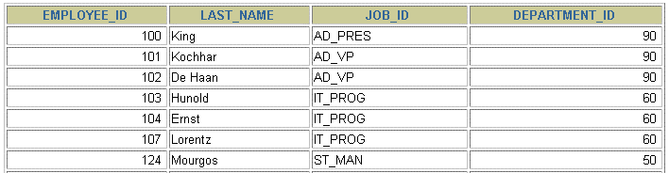

Limiting
Rows
Using
a
Selection
EMPLOYEES
…
“retrieve
all
employees in
department 90”
Copyright © 2004, Oracle.
All rights reserved.

Slide 28
Limiting the Rows That Are Selected
•
Restrict the rows that are returned by using
WHERE clause:
the
SELECT *|{[DISTINCT] column|expression [alias],...}
FROM table
[WHERE condition(s)];
•
The
WHERE clause
follows
the
FROM clause.
Copyright © 2004, Oracle. All rights reserved.

Slide 29

Using
the
WHERE Clause
SELECT employee_id, last_name, job_id, department_id
FROM employees
WHERE department_id = 90 ;
Copyright © 2004, Oracle. All rights reserved.

Slide 30
Character Strings and Dates
•
Character strings and date values are enclosed
single quotation marks.
by
•
Character values are case-sensitive, and
values are format-sensitive.
date
•
The
default
date
format
is
DD-MON-RR.
SELECT last_name, job_id, department_id
FROM employees
WHERE last_name = 'Whalen' ;
Copyright © 2004, Oracle. All rights reserved.

Slide 31
Comparison
Conditions
Operator
Meaning
=
Equal to
>
Greater than
>=
Greater than or equal to
<
Less than
<=
Less than or equal to
<>
Not equal to
BETWEEN
...AND...
Between two values
(inclusive)
IN(set)
Match any of a list of values
LIKE
Match a character pattern
IS NULL
Is a null value
Copyright © 2004, Oracle. All rights reserved.

Slide 32

Using Comparison
Conditions
SELECT last_name, salary
FROM employees
WHERE salary <= 3000 ;
Copyright © 2004, Oracle. All rights reserved.

Slide 33
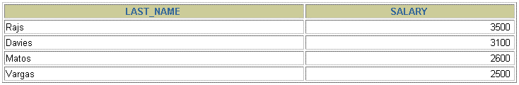
Using the BETWEEN Condition
Use the BETWEEN condition to
display rows
based
on
a
range
of
values:
SELECT last_name, salary
FROM employees
WHERE salary BETWEEN 2500 AND 3500 ;
Lower limit
Upper
limit
Copyright © 2004, Oracle.
All rights reserved.

Slide 34
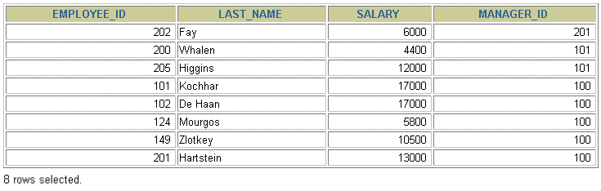
Using the IN Condition
Use the
IN membership
condition
to
test
for
values
in
a
list:
SELECT employee_id, last_name, salary, manager_id
FROM employees
WHERE manager_id IN (100, 101, 201) ;
Copyright © 2004, Oracle. All rights reserved.

Slide 35
Using the LIKE Condition
•
Use the LIKE condition to perform wildcard
searches of valid search string values.
•
Search conditions can contain either
characters or numbers:
literal
–
–
%
_
denotes
denotes
zero or many characters.
one
character.
SELECT first_name
FROM employees
WHERE first_name LIKE 'S%' ;
Copyright © 2004, Oracle. All rights reserved.

Slide 36

Using the LIKE Condition
•
You
can
combine
pattern-matching
characters:
SELECT last_name
FROM employees
WHERE last_name
LIKE '_o%'
;
•
You
can
use the ESCAPE identifier
and _ symbols.
to
search
for
the
actual %
Copyright © 2004, Oracle. All rights reserved.

Slide 37
Using
the
NULL Conditions
Test
for
nulls
with
the
IS
NULL operator.
SELECT last_name, manager_id
FROM employees
WHERE
manager_id IS NULL
;
Copyright © 2004, Oracle. All rights reserved.

Slide 38
Logical
Conditions
Operator
Meaning
AND
Returns TRUE if both component conditions are true
OR
Returns TRUE if either component condition is true
NOT
Returns TRUE if the following
condition is false
Copyright © 2004, Oracle. All rights reserved.

Slide 39

Using the AND Operator
AND requires
both
conditions
to
be
true:
SELECT employee_id, last_name, job_id, salary
FROM employees
WHERE salary >=10000
AND job_id LIKE '%MAN%' ;
Copyright © 2004, Oracle. All rights reserved.

Slide 40
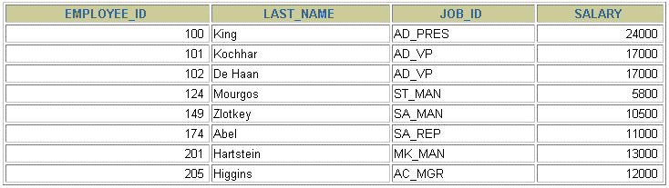
Using the OR Operator
OR requires
either
condition
to
be
true:
SELECT employee_id, last_name, job_id, salary
FROM employees
WHERE salary >= 10000
OR job_id LIKE '%MAN%' ;
Copyright © 2004, Oracle. All rights reserved.

Slide 41
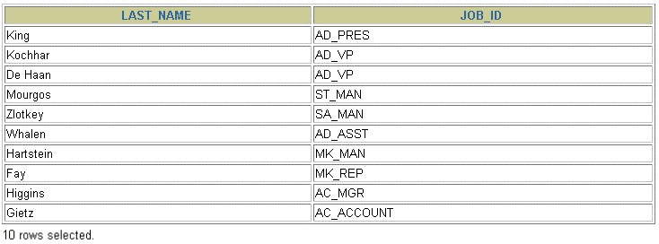
Using
the
NOT Operator
SELECT last_name, job_id
FROM employees
WHERE job_id
NOT IN ('IT_PROG', 'ST_CLERK', 'SA_REP') ;
Copyright © 2004, Oracle. All rights reserved.

Slide 42
Rules
of
Precedence
Operator
Meaning
1
Arithmetic operators
2
Concatenation operator
3
Comparison conditions
4
IS [NOT] NULL, LIKE, [NOT] IN
5
[NOT] BETWEEN
6
Not equal to
7
NOT logical condition
8
AND logical condition
9
OR logical condition
You can use parentheses to override rules
of precedence.
Copyright © 2004, Oracle. All rights reserved.

Slide 43
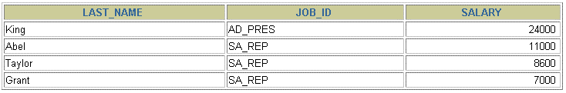
Rules of Precedence
SEL
FRO
WHE
job_id = 'AD_PRES'
salary > 15000;
SELECT
last_name, job_id,
employees
salary
FROM
WHERE
job_id
=
'SA_REP'
1
OR
AND
SELECT last_name, job_id, salary
FROM employees
OR job_id = 'AD_PRES')
AND salary > 15000;
2
WHERE
(job_id = 'SA_REP'
Copyright © 2004, Oracle.
All rights reserved.

Slide 44
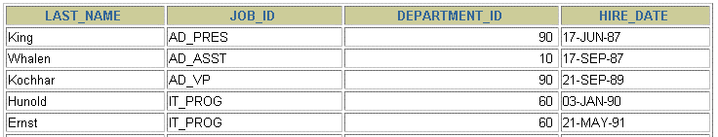
Using the ORDER
BY Clause
•
Sort retrieved rows with the
ORDER
BY clause:
–
–
ASC: ascending order, default
DESC: descending order
•
The ORDER
statement:
BY clause
comes
last
in
the
SELECT
SELECT last_name, job_id, department_id, hire_date
FROM employees
ORDER BY hire_date
;
…
Copyright © 2004, Oracle. All rights reserved.

Slide 45
Sorting
•
Sorting in descending order:
SELECT last_name, job_id, department_id, hire_date
FROM employees ₁
ORDER BY hire_date
DESC
;
•
Sorting
by
column alias:
SELECT employee_id, last_name, salary*12 annsal
^{FROM employees} 2
ORDER BY
annsal
;
•
Sorting
by
multiple columns:
SELECT last_name, department_id, salary
FROM
employees
3
ORDER BY department_id, salary DESC;
Copyright © 2004, Oracle. All rights reserved.

Slide 46
Summary
In
•
this lesson, you should have learned how to:
Use the WHERE clause to restrict rows of output:
–
–
–
Use the comparison conditions
Use the BETWEEN, IN, LIKE, and
NULL conditions
Apply the logical AND, OR, and NOT operators
•
Use the ORDER
BY clause to sort rows of output:
SELECT *|{[DISTINCT] column|expression [alias],...}
FROM table
[WHERE condition(s)]
[ORDER BY {column, expr, alias} [ASC|DESC]] ;
•
Use ampersand substitution in iSQL*Plus to
restrict and sort output at run time
Copyright © 2004, Oracle. All rights reserved.

Slide 47
Practice 2: Overview
This practice covers the following topics:
•
Selecting data and changing the order
the rows that are displayed
of
•
•
•
Restricting rows by using the
WHERE clause
Sorting rows by using the ORDER
BY clause
Using substitution variables to
add
flexibility
to
your
SQL
SELECT statements
Copyright © 2004, Oracle. All rights reserved.

Slide 48
Using
Single-Row Functions
to
Customize
Output
Copyright © 2004, Oracle. All rights reserved.

Slide 49
Objectives
After completing this lesson, you should be able to
do
the
•
following:
Describe various types of functions that are available in SQL
•
Use character, number, and date functions
SELECT statements
in
•
Describe
the
use
of
conversion
functions
Copyright © 2004, Oracle. All rights reserved.

Slide 50
SQL
Functions
Input
Output
Function
arg 1
Function performs action
arg 2
Result value
arg n
Copyright © 2004, Oracle. All rights reserved.

Slide 51
Two
Types
of
SQL
Functions
Functions
Single-row functions
Multiple-row functions
Return one result
per row
Return one result
per set of rows
Copyright © 2004, Oracle.
All rights reserved.

Slide 52
Single-Row Functions
Single-row functions:
•
•
•
•
•
•
•
Manipulate data items
Accept arguments and return one value
Act on each row that is returned
Return one result per row
May modify the data type
Can be nested
Accept arguments
expression
that can
be a column
or an
function_name [(arg1, arg2,...)]
Copyright © 2004, Oracle. All rights reserved.

Slide 53
Single-Row
Functions
Character
General
Single-row functions
Number
Conversion
Date
Copyright © 2004, Oracle. All rights reserved.

Slide 54
Character
Functions
Character functions
Case-manipulation
functions
Character-manipulation
functions
LOWER
UPPER INITCAP
CONCAT
SUBSTR
LENGTH
INSTR
LPAD |
TRIM
RPAD
REPLACE
Copyright © 2004, Oracle.
All rights reserved.

Slide 55
Case-Manipulation Functions
These
functions convert
case
for
character
strings:
Function
Result
LOWER('SQL Course')
sql course
UPPER('SQL Course')
SQL COURSE
INITCAP('SQL Course')
Sql Course
Copyright © 2004, Oracle.
All rights reserved.

Slide 56
Using Case-Manipulation
Functions
Display the employee number,
name,
and
department
number
for
employee
Higgins:
SELECT employee_id, last_name, department_id
FROM employees
WHERE last_name = 'higgins';
no rows selected
SELECT employee_id, last_name, department_id
FROM employees
WHERE LOWER(last_name) = 'higgins';
Copyright © 2004, Oracle. All rights reserved.

Slide 57
Character-Manipulation Functions
These
functions manipulate
character
strings:
Function
Result
CONCAT('Hello', 'World')
HelloWorld
SUBSTR('HelloWorld',1,5)
Hello
LENGTH('HelloWorld')
10
INSTR('HelloWorld', 'W')
6
LPAD(salary,10,'*')
*****24000
RPAD(salary, 10, '*')
24000*****
REPLACE
('JACK and JUE','J','BL')
BLACK and BLUE
TRIM('H' FROM 'HelloWorld')
elloWorld
Copyright © 2004, Oracle. All rights reserved.

Slide 58
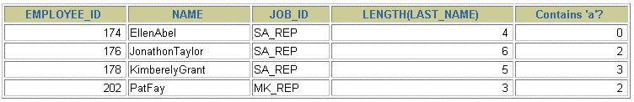
Using
the Character-Manipulation
Functions
1
SELECT employee_id, CONCAT(first_name, last_name) NAME,
INSTR(last_name, 'a') "Contains 'a'?"
WHERE SUBSTR(job_id, 4) = 'REP';
LENGTH (last_nam
2
job_id,
LENGTH
(last_name),
3
FROM
employees
1
2
3
Copyright © 2004, Oracle.
All rights reserved.

Slide 59
Number Functions
•
•
•
ROUND: Rounds value to specified decimal
TRUNC: Truncates value to specified
decimal
MOD:
Returns
remainder
of
division
Function
Result
ROUND(45.926, 2)
45.93
TRUNC(45.926, 2)
45.92
MOD(1600, 300)
100
Copyright © 2004, Oracle. All rights reserved.

Slide 60
Using
the
ROUND Function
1
2
SELECT ROUND(45.923,2), ROUND(45.923,0),
FROM DUAL;
ROUND(45.923,-1)
3
1
2
3
results
DUAL is a dummy table that you can use to view
from functions and calculations.
Copyright © 2004, Oracle. All rights reserved.

Slide 61
Using
the
TRUNC Function
1
2
SELECT ROUND(45.923,2), ROUND(45.923),
FROM DUAL;
ROUND(45.923,-1)
3
1
2
3
Copyright © 2004, Oracle.
All rights reserved.

Slide 62

Using the MOD Function
For all employees with job title of Sales Representative,
calculate
the
remainder
of
the
salary
after
it
is
divided
by
5,000.
SELECT last_name, salary, MOD(salary, 5000)
FROM employees
WHERE job_id = 'SA_REP';
Copyright © 2004, Oracle. All rights reserved.

Slide 63

Working with Dates
•
The Oracle database stores dates in an internal numeric
format: century, year, month, day, hours, minutes, and seconds.
The default date display format is DD-MON-RR.
•
–
Enables you to store 21st-century dates in the
20th century by specifying only the last two digits of the year
–
Enables you
to store 20th-century
dates
in
the
21st
century
in
the
same
way
SELECT last_name, hire_date
FROM employees
WHERE hire_date < '01-FEB-88';
Copyright © 2004, Oracle. All rights reserved.

Slide 64
Working with Dates
SYSDATE is
a
function
that
returns:
•
•
Date
Time
Copyright © 2004, Oracle. All rights reserved.

Slide 65
Arithmetic with Dates
•
Add or subtract a number to or from a
resultant date value.
Subtract two dates to find the number between those dates.
date for
a
•
of days
•
Add hours to
a
date
by
dividing
the
number
of
hours
by
24.
Copyright © 2004, Oracle.
All rights reserved.

Slide 66

Using
Arithmetic Operators
with
Dates
SELECT last_name, (SYSDATE-hire_date)/7 AS WEEKS
FROM employees
WHERE department_id = 90;
Copyright © 2004, Oracle. All rights reserved.

Slide 67
Date
Functions
Function
Result
MONTHS_BETWEEN
Number of months between two dates
ADD_MONTHS
Add calendar months to date
NEXT_DAY
Next day of the date specified
LAST_DAY
Last day of the month
ROUND
Round date
TRUNC
Truncate date
Copyright © 2004, Oracle. All rights reserved.

Slide 68
Using
Date
Functions
Function
Result
MONTHS_BETWEEN
('01-SEP-95','11-JAN-94')
19.6774194
ADD_MONTHS ('11-JAN-94',6)
'11-JUL-94'
NEXT_DAY ('01-SEP-95','FRIDAY')
'08-SEP-95'
LAST_DAY ('01-FEB-95')
'28-FEB-95'
Copyright © 2004, Oracle. All rights reserved.

Slide 69
Using Date Functions
Assume
SYSDATE
= '25-JUL-03':
Function
Result
ROUND(SYSDATE,'MONTH')
01-AUG-03
ROUND(SYSDATE ,'YEAR')
01-JAN-04
TRUNC(SYSDATE ,'MONTH')
01-JUL-03
TRUNC(SYSDATE ,'YEAR')
01-JAN-03
Copyright © 2004, Oracle. All rights reserved.

Slide 70
Practice 3: Overview of Part 1
This practice covers the following topics:
•
•
Writing a query that displays the
Creating queries that require the character, and date functions
current date
use of numeric,
•
Performing calculations
of
years
and
months
of
service
for
an
employee
Copyright © 2004, Oracle.
All rights reserved.

Slide 71
Conversion
Functions
Data type conversion
Implicit data
type
Explicit data type
conversion
conversion
Copyright © 2004, Oracle.
All rights reserved.

Slide 72
Implicit Data Type Conversion
For assignments, the Oracle
server
can
automatically
convert
the
following:
From
To
VARCHAR2 or CHAR
NUMBER
VARCHAR2 or CHAR
DATE
NUMBER
VARCHAR2
DATE
VARCHAR2
Copyright © 2004, Oracle.
All rights reserved.

Slide 73
Implicit Data Type Conversion
For expression evaluation, the Oracle
Server
can
automatically
convert
the
following:
From
To
VARCHAR2 or CHAR
NUMBER
VARCHAR2 or CHAR
DATE
Copyright © 2004, Oracle. All rights reserved.

Slide 74
Explicit Data
Type
Conversion
TO_NUMBER
TO_DATE
NUMBER
CHARACTER
DATE
TO_CHAR
TO_CHAR
Copyright © 2004, Oracle. All rights reserved.

Slide 75
Explicit Data
Type
Conversion
TO_NUMBER
TO_DATE
NUMBER
CHARACTER
DATE
TO_CHAR
TO_CHAR
Copyright © 2004, Oracle. All rights reserved.

Slide 76
Using the TO_CHAR Function
with
Dates
TO_CHAR(date, 'format_model')
The
•
•
•
•
format model:
Must be enclosed by single quotation marks
Is case-sensitive
Can include any valid date format element
Has an fm element to remove padded blanks or suppress leading zeros
Is separated from the date value by a comma
•
Copyright © 2004, Oracle. All rights reserved.

Slide 77
Elements
of
the
Date
Format
Model
Element
Result
YYYY
Full year in numbers
YEAR
Year spelled out (in English)
MM
Two-digit value for month
MONTH
Full name of the month
MON
Three-letter abbreviation of the month
DY
Three-letter abbreviation of the day of the week
DAY
Full name of the day of the week
DD
Numeric day of the month
Copyright © 2004, Oracle. All rights reserved.

Slide 78
Elements of the Date Format Model
•
Time elements format
the time portion of
the date:
HH24:MI:SS AM
15:45:32 PM
•
Add character strings
quotation marks:
by enclosing them
in
double
DD "of" MONTH
12 of OCTOBER
•
Number
suffixes spell
out
numbers:
ddspth
fourteenth
Copyright © 2004, Oracle. All rights reserved.

Slide 79
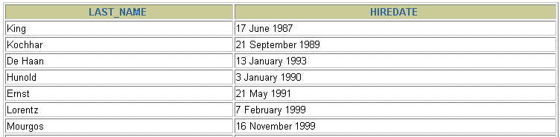
Using
the
TO_CHAR Function
with
Dates
SELECT last_name,
TO_CHAR(hire_date, 'fmDD Month YYYY')
AS HIREDATE
FROM employees;
…
Copyright © 2004, Oracle. All rights reserved.

Slide 80
Using the TO_CHAR Function with Numbers
TO_CHAR(number, 'format_model')
These are some of the format elements that you can
use with the TO_CHAR function
to
display
a
number
value
as
a
character:
Element
Result
9
Represents a number
0
Forces a zero to be displayed
$
Places a floating dollar sign
L
Uses the floating local currency symbol
.
Prints a decimal point
,
Prints a comma as thousands indicator
Copyright © 2004, Oracle.
All rights reserved.

Slide 81
Using
the
TO_CHAR Function
with
Numbers
SELECT TO_CHAR(salary, '$99,999.00') SALARY
FROM employees
WHERE last_name = 'Ernst';
Copyright © 2004, Oracle. All rights reserved.

Slide 82
Using the TO_NUMBER and TO_DATE
Functions
•
Convert a character string to a number format
using the TO_NUMBER function:
TO_NUMBER(char[, 'format_model'])
•
Convert a character string to a date format using
the TO_DATE function:
TO_DATE(char[, 'format_model'])
•
These functions have an fx modifier. This
modifier specifies the exact matching for the character argument and date format model of a TO_DATE function.
Copyright © 2004, Oracle. All rights reserved.

Slide 83
RR
Date
Format
Current Year
Specified Date
RR Format
YY Format
1995
1995
2001
2001
27-OCT-95
27-OCT-17
27-OCT-17
27-OCT-95
1995
2017
2017
1995
1995
1917
2017
2095
If the specified two-digit year is:
0–49 50–99
If two digits of the current
year are:
The return date is in The return date is in
the current one
0–49
the current century
the century before
The return date is in The return date is in
50–99 the century after the current century
the current one
Copyright © 2004, Oracle. All rights reserved.

Slide 84

Example of RR Date Format
To find employees hired prior to 1990, use the RR date
format, which produces the same
results
whether
the
command
is
run
in
1999
or
now:
SELECT last_name, TO_CHAR(hire_date, 'DD-Mon-YYYY')
FROM employees
WHERE hire_date < TO_DATE('01-Jan-90','DD-Mon-RR');
Copyright © 2004, Oracle. All rights reserved.

Slide 85
Nesting Functions
•
•
Single-row functions can be nested to any level.
Nested functions are evaluated
from
deepest
level
to
the
least
deep
level.
F3(F2(F1(col,arg1),arg2),arg3)
Step 2 = Result 2
Step 1 = Result 1
Step 3 = Result 3
Copyright © 2004, Oracle.
All rights reserved.

Slide 86

Nesting
Functions
SELECT last_name,
UPPER(CONCAT(SUBSTR (LAST_NAME, 1, 8), '_US'))
FROM employees
WHERE department_id = 60;
Copyright © 2004, Oracle. All rights reserved.

Slide 87
General Functions
The following functions work with any data
pertain to using nulls:
type and
•
•
•
•
NVL
NVL2
(expr1,
(expr1,
expr2)
expr2,
expr3)
NULLIF
(expr1,
expr2)
COALESCE
(expr1,
expr2,
...,
exprn)
Copyright © 2004, Oracle. All rights reserved.

Slide 88
NVL Function
Converts a null value to an actual value:
•
Data types that can be used are date,
and number.
Data types must match:
character,
•
–
–
–
NVL(commission_pct,0)
NVL(hire_date,'01-JAN-97')
NVL(job_id,'No
Job Yet')
Copyright © 2004, Oracle. All rights reserved.

Slide 89
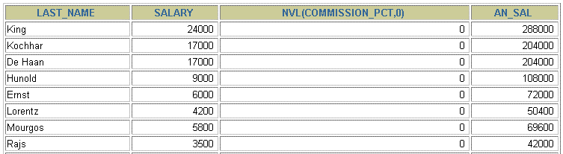
Using
the
NVL Function
SELECT last_name, salary, NVL(commission_pct, 0), 1
(salary*12) + (salary*12*NVL(commission_pct, 0)) AN_SAL
FROM employees;
2
…
1
2
Copyright © 2004, Oracle. All rights reserved.

Slide 90
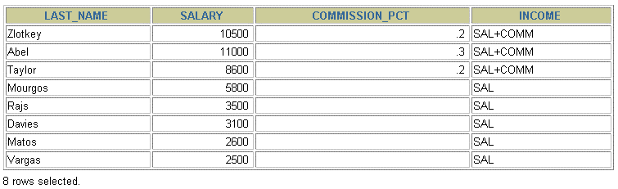
Using
the
NVL2 Function
SELECT last_name, salary, commission_pct, 1
NVL2(commission_pct,
FROM employees WHERE department_id IN (50, 80);
'SAL+COMM', 'SAL') income
2
1
2
Copyright © 2004, Oracle. All rights reserved.

Slide 91
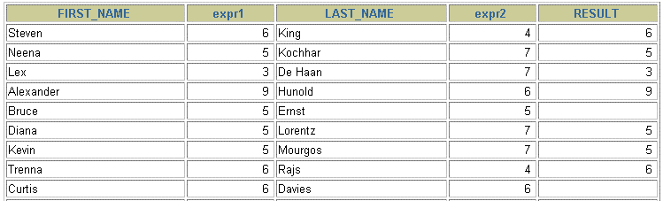
Using
the
NULLIF Function
1
SELECT
FROM
first_name,
last_name,
LENGTH(first_name) "expr1",
2
LENGTH(last_name) "expr2",
NULLIF(LENGTH(first_name), LENGTH(last_name)) result
3
employees;
…
1
2
3
Copyright © 2004, Oracle. All rights reserved.

Slide 92
Using the COALESCE Function
•
The advantage of the COALESCE function over the
NVL function is that the COALESCE function can
take multiple alternate values.
If the first expression is not null, the COALESCE
function returns that expression; otherwise, it
•
does
a
COALESCE of
the
remaining
expressions.
Copyright © 2004, Oracle. All rights reserved.

Slide 93
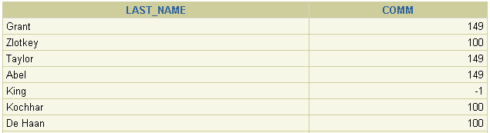
Using
the
COALESCE Function
SELECT last_name,
COALESCE(manager_id,commission_pct, -1) comm
FROM employees
ORDER BY commission_pct;
…
Copyright © 2004, Oracle. All rights reserved.

Slide 94
Conditional Expressions
•
Provide the use of IF-THEN-ELSE
SQL statement
logic
within
a
•
Use two
methods:
expression
–
–
CASE
DECODE function
Copyright © 2004, Oracle.
All rights reserved.

Slide 95
CASE Expression
Facilitates conditional inquiries
by
doing
the
work
of
an
IF-THEN-ELSE
statement:
CASE expr WHEN comparison_expr1 THEN return_expr1
[WHEN comparison_expr2 THEN return_expr2
WHEN comparison_exprn THEN return_exprn
ELSE else_expr]
END
Copyright © 2004, Oracle.
All rights reserved.

Slide 96
Using the CASE Expression
Facilitates conditional inquiries
by
doing
the
work
of
an
IF-THEN-ELSE
statement:
SELECT last_name, job_id, salary,
CASE job_id WHEN 'IT_PROG' THEN 1.10*salary
WHEN 'ST_CLERK' THEN 1.15*salary
WHEN 'SA_REP' THEN 1.20*salary
ELSE salary END "REVISED_SALARY"
FROM employees;
…
…
Copyright © 2004, Oracle.
All rights reserved.

Slide 97
DECODE Function
Facilitates conditional inquiries by doing the work
of
a
CASE expression
or
an
IF-THEN-ELSE
statement:
DECODE(col|expression, search1, result1
[, search2, result2,...,]
[, default])
Copyright © 2004, Oracle. All rights reserved.

Slide 98
Using
the
DECODE Function
SELECT last_name, job_id, salary,
DECODE(job_id, 'IT_PROG', 1.10*salary,
'ST_CLERK', 1.15*salary,
'SA_REP', 1.20*salary,
salary)
REVISED_SALARY
FROM employees;
…
…
Copyright © 2004, Oracle. All rights reserved.

Slide 99
Using the DECODE Function
Display the applicable
tax
rate
for
each
employee
in
department
80:
SELECT last_name, salary,
DECODE (TRUNC(salary/2000, 0),
0, 0.00,
1, 0.09,
2, 0.20,
3, 0.30,
4, 0.40,
5, 0.42,
6, 0.44,
0.45) TAX_RATE
FROM employees
WHERE department_id = 80;
Copyright © 2004, Oracle. All rights reserved.

Slide 100
Summary
In
•
•
•
this lesson, you should have learned how to:
Perform calculations on data using functions
Modify individual data items using functions
Manipulate output for groups of rows using
functions
Alter date formats for display using functions
•
•
•
•
Convert column data types
using
functions
Use
Use
NVL functions
IF-THEN-ELSE logic
Copyright © 2004, Oracle. All rights reserved.

Slide 101
Practice 3: Overview of Part 2
This practice covers the following topics:
•
Creating queries that require the use of numeric,
character, and date functions
Using concatenation with functions
Writing case-insensitive queries to test the usefulness of character functions
•
•
•
Performing calculations of years and months
service for an employee
Determining the review date for an employee
of
•
Copyright © 2004, Oracle. All rights reserved.

Slide 102
Reporting Aggregated Data
Using
the
Group
Functions
Copyright © 2004, Oracle. All rights reserved.

Slide 103
Objectives
After completing this lesson, you should be able to
do
the
•
•
•
•
following:
Identify the available group functions
Describe the use of group functions
Group data by using the GROUP
BY clause
Include or exclude
HAVING clause
grouped
rows
by
using
the
Copyright © 2004, Oracle.
All rights reserved.

Slide 104
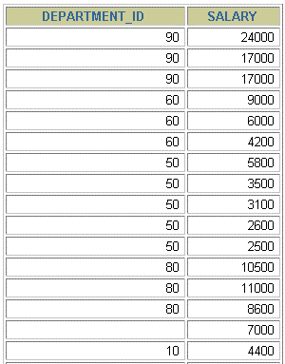

What Are Group Functions?
Group functions operate
result per group.
EMPLOYEES
on
sets
of
rows
to
give
one
Maximum salary in
EMPLOYEES table
…
Copyright © 2004, Oracle. All rights reserved.

Slide 105
Types
of
Group
Functions
•
•
•
•
•
•
•
AVG
COUNT
MAX
MIN
STDDEV
SUM
VARIANCE
Group functions
Copyright © 2004, Oracle. All rights reserved.

Slide 106
Group
Functions:
Syntax
SELECT [column,] group_function(column), ...
FROM table
[WHERE condition]
[GROUP BY column]
[ORDER BY column];
Copyright © 2004, Oracle. All rights reserved.

Slide 107
Using the AVG and SUM Functions
You
can
use
AVG and
SUM for numeric
data.
SELECT AVG(salary), MAX(salary),
MIN(salary), SUM(salary)
FROM employees
WHERE job_id LIKE '%REP%';
Copyright © 2004, Oracle. All rights reserved.

Slide 108
Using the MIN and MAX Functions
You can use MIN and
MAX for numeric,
character,
and
date
data
types.
SELECT MIN(hire_date), MAX(hire_date)
FROM employees;
Copyright © 2004, Oracle. All rights reserved.

Slide 109
Using the COUNT Function
COUNT(*) returns the
number of rows in a
table:
SELECT COUNT(*)
FROM employees
WHERE department_id = 50;
1
COUNT(expr) returns
the
number
of
rows
with
non-
null
values
for
the
expr:
SELECT COUNT(commission_pct)
FROM employees
WHERE department_id = 80;
2
Copyright © 2004, Oracle.
All rights reserved.

Slide 110
Using the
DISTINCT Keyword
•
COUNT(DISTINCT
expr) returns the number
of
distinct non-null values of the expr.
•
To display the number of distinct
department
values
in
the
EMPLOYEES table:
SELECT COUNT(DISTINCT department_id)
FROM employees;
Copyright © 2004, Oracle. All rights reserved.

Slide 111
Group Functions and Null Values
Group functions ignore null values in the column:
SELECT AVG(commission_pct)
FROM employees;
1
The
null
NVL function
values:
forces
group
functions
to
include
SELECT AVG(NVL(commission_pct, 0))
FROM employees;
2
Copyright © 2004, Oracle. All rights reserved.

Slide 112
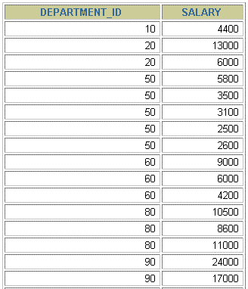
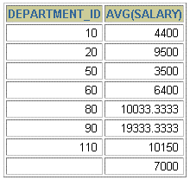
Creating
Groups
of Data
EMPLOYEES
4400
9500
₃₅₀₀ Average salary in
EMPLOYEES
6400 table for each
department
10033
…
Copyright © 2004, Oracle. All rights reserved.

Slide 113
Creating Groups of Data:
GROUP
BY Clause
Syntax
SELECT column, group_function(column)
FROM table
[WHERE condition]
[GROUP BY group_by_expression]
[ORDER BY column];
You can divide rows
in a table
into
smaller
groups
by
using
the
GROUP
BY clause.
Copyright © 2004, Oracle.
All rights reserved.

Slide 114
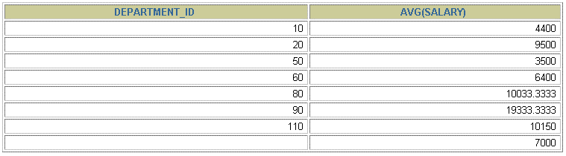
Using the
GROUP BY Clause
All columns in the
SELECT list that
are not
clause.
in
group
functions
must
be
in
the
GROUP
BY
SELECT department_id, AVG(salary)
FROM employees
GROUP BY department_id ;
Copyright © 2004, Oracle. All rights reserved.

Slide 115
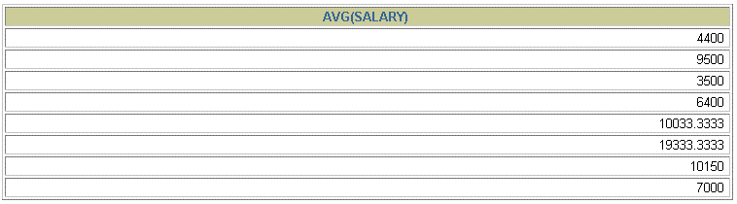
Using the GROUP BY Clause
The GROUP BY column
SELECT list.
does
not
have
to
be
in
the
SELECT AVG(salary) FROM employees
GROUP BY department_id
;
Copyright © 2004, Oracle. All rights reserved.

Slide 116
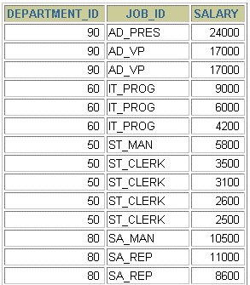
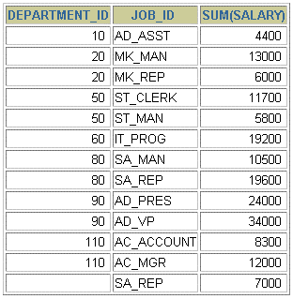

Grouping
by
More
Than
One
Column
EMPLOYEES
Add the
salaries in
the EMPLOYEES
table for each job,
grouped by
department
…
Copyright © 2004, Oracle. All rights reserved.

Slide 117
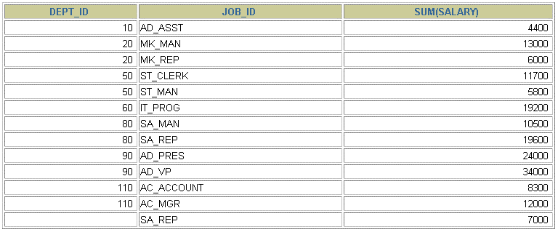
Using
on
the GROUP BY Clause
Multiple
Columns
SELECT department_id dept_id, job_id, SUM(salary)
FROM employees
GROUP BY department_id, job_id ;
Copyright © 2004, Oracle. All rights reserved.

Slide 118
Illegal Queries
Using Group Functions
Any column or expression in the SELECT list that is not
an
aggregate
function
must
be
in
the
GROUP
BY clause:
SELECT department_id, COUNT(last_name)
FROM employees;
SELECT department_id, COUNT(last_name)
*
ERROR at line 1:
ORA-00937: not a single-group group function
Column missing in the GROUP BY clause
Copyright © 2004, Oracle. All rights reserved.

Slide 119
Illegal Queries
Using Group Functions
•
•
•
You
You
You
cannot use the
WHERE clause to restrict groups.
use the HAVING clause to restrict groups.
cannot
use
group
functions
in
the
WHERE clause.
SELECT department_id, AVG(salary)
FROM employees
WHERE AVG(salary) > 8000
GROUP BY department_id;
WHERE AVG(salary) > 8000
*
ERROR at line 3:
ORA-00934: group function is not allowed here
Cannot use the WHERE clause to
restrict groups
Copyright © 2004, Oracle. All rights reserved.

Slide 120
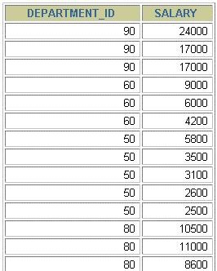
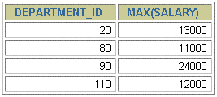

Restricting
Group
Results
EMPLOYEES
The maximum
salary
per department
when it is
greater than
$10,000
…
Copyright © 2004, Oracle. All rights reserved.

Slide 121
Restricting Group Results
with
the
HAVING Clause
When you use the
HAVING clause, the Oracle
server
restricts groups as follows:
1.
2.
3.
Rows are grouped.
The group function is applied.
Groups matching
displayed.
the
HAVING clause
are
SELECT column, group_function
FROM table
[WHERE condition]
[GROUP BY group_by_expression]
[HAVING group_condition]
[ORDER BY column];
Copyright © 2004, Oracle. All rights reserved.

Slide 122
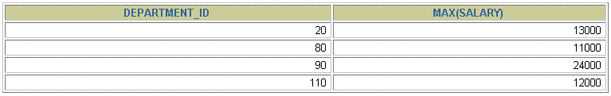
Using
the
HAVING Clause
SELECT department_id, MAX(salary)
FROM employees
GROUP BY department_id
HAVING MAX(salary)>10000 ;
Copyright © 2004, Oracle. All rights reserved.

Slide 123

Using
the
HAVING Clause
SELECT job_id, SUM(salary) PAYROLL
FROM employees
WHERE job_id NOT LIKE '%REP%'
GROUP BY job_id
HAVING SUM(salary) > 13000
ORDER BY SUM(salary);
Copyright © 2004, Oracle. All rights reserved.

Slide 124
Nesting Group
Functions
Display
the
maximum
average
salary:
SELECT MAX(AVG(salary))
FROM employees
GROUP BY department_id;
Copyright © 2004, Oracle. All rights reserved.

Slide 125
Summary
In
•
•
•
this lesson, you should have learned how to:
Use the group functions COUNT, MAX, MIN, and
AVG
Write
Write
queries
queries
that
that
use
use
the
the
GROUP BY clause
HAVING clause
SELECT column, group_function
FROM table
[WHERE condition]
[GROUP BY group_by_expression]
[HAVING group_condition]
[ORDER BY column];
Copyright © 2004, Oracle. All rights reserved.

Slide 126
Practice 4: Overview
This practice covers the following topics:
•
•
•
Writing queries that use the group functions
Grouping by rows to achieve more than one result
Restricting
groups
by
using
the
HAVING clause
Copyright © 2004, Oracle. All rights reserved.

Slide 127
Objectives
After completing this lesson, you should be able to
do the following:
Write SELECT statements to access data from more than one table using equality and nonequality joins
View data that generally does not meet a join condition by using outer joins
Join a table to itself by using a self join
Notes:
Lesson Aim
This lesson covers how to obtain data from more than one table.

Slide 128

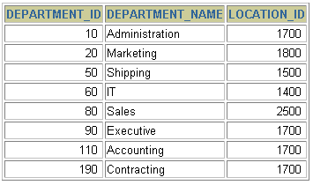



Obtaining Data from Multiple Tables
EMPLOYEES
DEPARTMENTS
…
…
Notes:
Data from Multiple Tables
Sometimes you need to use data from more than one table. In the slide example, the report displays data from two separate tables.
Employee IDs exist in the EMPLOYEES table.
Department IDs exist in both the EMPLOYEES and DEPARTMENTS tables.
Location IDs exist in the DEPARTMENTS table.
To produce the report, you need to link the EMPLOYEES and DEPARTMENTS tables and access data from both of them.

Slide 129
Cartesian Products
A Cartesian product is formed when:
  A join condition is omitted
  A join condition is invalid
  All rows in the first table are joined to all rows in the second table
To avoid a Cartesian product, always include a valid join condition in a WHERE clause.
Notes:
Cartesian Products
When a join condition is invalid or omitted completely, the result is a Cartesian product, in which all combinations of rows are displayed. All rows in the first table are joined to all rows in the second table.
A Cartesian product tends to generate a large number of rows, and the result is rarely useful. You should always include a valid join condition in a WHERE clause, unless you have a specific need to combine all rows from all tables.
Cartesian products are useful for some tests when you need to generate a large number of rows to simulate a reasonable amount of data.

Slide 130
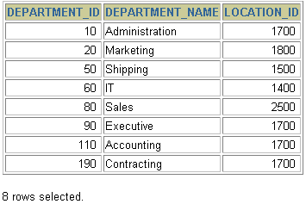
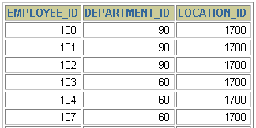
Generating a Cartesian Product
EMPLOYEES (20 rows)
DEPARTMENTS (8 rows)
…
Cartesian
product:
20x8=160 rows
…
Notes:
Cartesian Products (continued)
A Cartesian product is generated if a join condition is omitted. The example on the slide displays employee last name and department name from the EMPLOYEES and DEPARTMENTS tables. Because no WHERE clause has been specified, all rows (20 rows) from the EMPLOYEES table are joined with all rows (8 rows) in the DEPARTMENTS table, thereby generating 160 rows in the output.
SELECT last_name, department_name dept_name
FROM employees, departments;
Instructor Note
Demo: 4_cart.sql
Purpose: To illustrate executing a Cartesian product
…

Slide 131
Types of Joins
  Oracle Proprietary
  Joins (8i and prior):
  SQL: 1999
  Compliant Joins:
Equijoin
Non-equijoin
Outer join
Self join
Cross joins
Full or two sided outer joins
Arbitrary join conditions for outer joins
Notes:
Types of Joins
The Oracle9i database offers join syntax that is SQL: 1999 compliant. Prior to the 9i release, the join syntax was different from the ANSI standards. The new SQL: 1999 compliant join syntax does not offer any performance benefits over the Oracle proprietary join syntax that existed in prior releases.
Instructor Note
Do not get into details of all the types of joins now. Explain each join one by one, as is done in the following slides.

Slide 132
Joining Tables Using Oracle Syntax
Use a join to query data from more than one table.
Write the join condition in the WHERE clause.
Prefix the column name with the table name when the same column name appears in more than one table.
SELECT table1.column, table2.column
FROM table1, table2
WHERE table1.column1 = table2.column2;
Notes:
Defining Joins
When data from more than one table in the database is required, a join condition is used. Rows in one table can be joined to rows in another table according to common values existing in corresponding columns, that is, usually primary and foreign key columns.
To display data from two or more related tables, write a simple join condition in the WHERE clause.
In the syntax:
table1.column denotes the table and column from which data is retrieved
table1.column1 = is the condition that joins (or relates) the tables together
table2.column2
Guidelines
When writing a SELECT statement that joins tables, precede the column name with the table name for clarity and to enhance database access.
If the same column name appears in more than one table, the column name must be prefixed with the table name.
To join n tables together, you need a minimum of n-1 join conditions. For example, to join four tables, a minimum of three joins is required. This rule may not apply if your table has a concatenated primary key, in which case more than one column is required to uniquely identify each row.
For more information, see Oracle9i SQL Reference, “SELECT.”

Slide 133
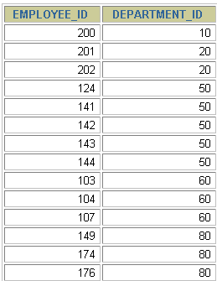
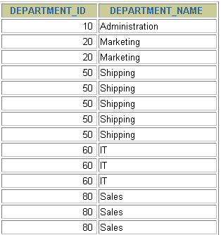
What is an Equijoin?
EMPLOYEES
DEPARTMENTS
…
…
Foreign key
Primary key
Notes:
Equijoins
To determine an employee’s department name, you compare the value in the DEPARTMENT_ID column in the EMPLOYEES table with the DEPARTMENT_ID values in the DEPARTMENTS table. The relationship between the EMPLOYEES and DEPARTMENTS tables is an equijoin—that is, values in the DEPARTMENT_ID column on both tables must be equal. Frequently, this type of join involves primary and foreign key complements.
Note: Equijoins are also called simple joins or inner joins.
Instructor Note
Explain the use of a decision matrix for simplifying writing joins. For example, if you want to display the name and department number of all the employees who are in the same department as Goyal, you can start by making the following decision tree:
Columns to Display Originating Table Condition
last_name employees last_name='Goyal'
department_name departments employees.department_id =
departments.department_id
Now the SQL statement can be easily formulated by looking at the decision matrix. The first column gives the column list in the SELECT statement, the second column gives the tables for the FROM clause, and the third column gives the condition for the WHERE clause.

Slide 134
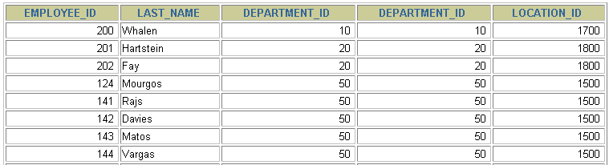
Retrieving Records with Equijoins
SELECT employees.employee_id, employees.last_name,
employees.department_id, departments.department_id,
departments.location_id
FROM employees, departments
WHERE employees.department_id = departments.department_id;
…
Notes:
Retrieving Records with Equijoins
In the slide example:
The SELECT clause specifies the column names to retrieve:
employee last name, employee number, and department number, which are columns in the EMPLOYEES table
department number, department name, and location ID, which are columns in the DEPARTMENTS table
The FROM clause specifies the two tables that the database must access:
EMPLOYEES table
DEPARTMENTS table
The WHERE clause specifies how the tables are to be joined:
EMPLOYEES.DEPARTMENT_ID = DEPARTMENTS.DEPARTMENT_ID
Because the DEPARTMENT_ID column is common to both tables, it must be prefixed by the table name to avoid ambiguity.

Slide 135
Qualifying Ambiguous
Column Names
Use table prefixes to qualify column names that are in multiple tables.
Improve performance by using table prefixes.
Distinguish columns that have identical names but reside in different tables by using column aliases.
Notes:
Qualifying Ambiguous Column Names
You need to qualify the names of the columns in the WHERE clause with the table name to avoid ambiguity. Without the table prefixes, the DEPARTMENT_ID column could be from either the DEPARTMENTS table or the EMPLOYEES table. It is necessary to add the table prefix to execute your query.
If there are no common column names between the two tables, there is no need to qualify the columns. However, using the table prefix improves performance, because you tell the Oracle Server exactly where to find the columns.
The requirement to qualify ambiguous column names is also applicable to columns that may be ambiguous in other clauses, such as the SELECT clause or the ORDER BY clause.
Instructor Note
Demo: 4_loc.sql
Purpose: To illustrate a SELECT clause with no aliases.

Slide 136
Using Table Aliases
Simplify queries by using table aliases.
Improve performance by using table prefixes.
SELECT e.employee_id, e.last_name, e.department_id,
d.department_id, d.location_id
FROM employees e , departments d
WHERE e.department_id = d.department_id;
Notes:
Table Aliases
Qualifying column names with table names can be very time consuming, particularly if table names are lengthy. You can use table aliases instead of table names. Just as a column alias gives a column another name, a table alias gives a table another name. Table aliases help to keep SQL code smaller, therefore using less memory.
Notice how table aliases are identified in the FROM clause in the example. The table name is specified in full, followed by a space and then the table alias. The EMPLOYEES table has been given an alias of e, and the DEPARTMENTS table has an alias of d.
Guidelines
Table aliases can be up to 30 characters in length, but shorter is better.
If a table alias is used for a particular table name in the FROM clause, then that table alias must be substituted for the table name throughout the SELECT statement.
Table aliases should be meaningful.
The table alias is valid only for the current SELECT statement.

Slide 137
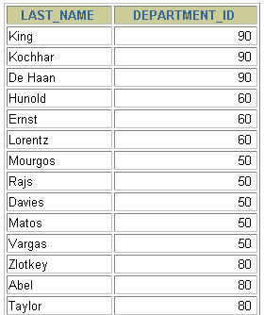
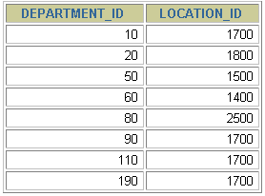
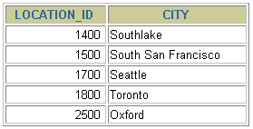
Joining More than Two Tables
EMPLOYEES
DEPARTMENTS
LOCATIONS
…
To join n tables together, you need a minimum of n-1 join conditions. For example, to join three tables, a minimum of two joins is required.
Notes:
Additional Search Conditions
Sometimes you may need to join more than two tables. For example, to display the last name, the department name, and the city for each employee, you have to join the EMPLOYEES, DEPARTMENTS, and LOCATIONS tables.
SELECT e.last_name, d.department_name, l.city
FROM employees e, departments d, locations l
WHERE e.department_id = d.department_id
AND d.location_id = l.location_id;
…

Slide 138
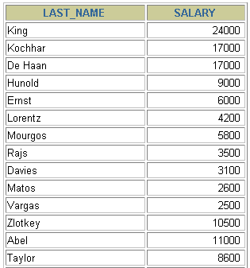
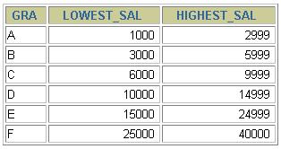
Non-Equijoins
EMPLOYEES
JOB_GRADES
Salary in the EMPLOYEES
table must be between
lowest salary and highest
salary in the JOB_GRADES
table.
…
Notes:
Non-Equijoins
A non-equijoin is a join condition containing something other than an equality operator.
The relationship between the EMPLOYEES table and the JOB_GRADES table has an example of a non-equijoin. A relationship between the two tables is that the SALARY column in the EMPLOYEES table must be between the values in the LOWEST_SALARY and HIGHEST_SALARY columns of the JOB_GRADES table. The relationship is obtained using an operator other than equals (=).

Slide 139
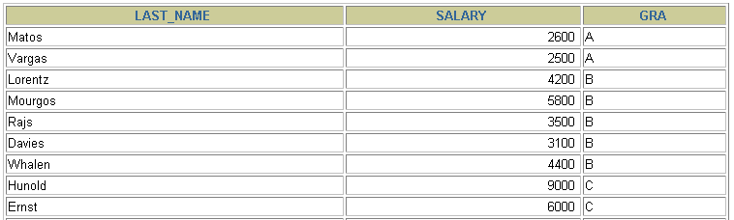
Retrieving Records with Non-Equijoins
SELECT e.last_name, e.salary, j.grade_level
FROM employees e, job_grades j
WHERE e.salary
BETWEEN j.lowest_sal AND j.highest_sal;
…
Notes:
Non-Equijoins (continued)
The slide example creates a non-equijoin to evaluate an employee’s salary grade. The salary must be between any pair of the low and high salary ranges.
It is important to note that all employees appear exactly once when this query is executed. No employee is repeated in the list. There are two reasons for this:
None of the rows in the job grade table contain grades that overlap. That is, the salary value for an employee can lie only between the low salary and high salary values of one of the rows in the salary grade table.
All of the employees’ salaries lie within the limits provided by the job grade table. That is, no employee earns less than the lowest value contained in the LOWEST_SAL column or more than the highest value contained in the HIGHEST_SAL column.
Note: Other conditions, such as <= and >= can be used, but BETWEEN is the simplest. Remember to specify the low value first and the high value last when using BETWEEN.
Table aliases have been specified in the slide example for performance reasons, not because of possible ambiguity.
Instructor Note
Explain that BETWEEN … AND … is actually translated by the Oracle server to a pair of AND conditions (a >= lower limit) and (a <= higher limit) and IN ( … ) is translated by the Oracle server to a set of OR conditions (a = value1 OR a = value2 OR a = value3 ). So using BETWEEN … AND … , IN(…) has no performance benefits; the benefit is logical simplicity.

Slide 140
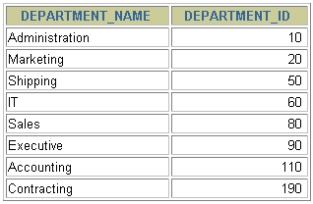
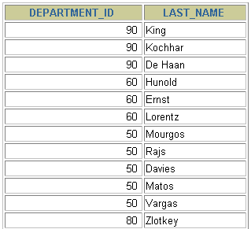
Outer Joins
DEPARTMENTS
EMPLOYEES
…
There are no employees in department 190.
Notes:
Returning Records with No Direct Match with Outer Joins
If a row does not satisfy a join condition, the row will not appear in the query result. For example, in the equijoin condition of EMPLOYEES and DEPARTMENTS tables, employee Grant does not appear because there is no department ID recorded for her in the EMPLOYEES table. Instead of seeing 20 employees in the result set, you see 19 records.
SELECT e.last_name, e.department_id, d.department_name
FROM employees e, departments d
WHERE e.department_id = d.department_id;
…

Slide 141
Outer Joins Syntax
You use an outer join to also see rows that do not meet the join condition.
The Outer join operator is the plus sign (+).
SELECT table1.column, table2.column
FROM table1, table2
WHERE table1.column(+) = table2.column;
SELECT table1.column, table2.column
FROM table1, table2
WHERE table1.column = table2.column(+);
Notes:
Using Outer Joins to Return Records with No Direct Match
The missing rows can be returned if an outer join operator is used in the join condition. The operator is a plus sign enclosed in parentheses (+), and it is placed on the “side” of the join that is deficient in information. This operator has the effect of creating one or more null rows, to which one or more rows from the nondeficient table can be joined.
In the syntax:
table1.column = is the condition that joins (or relates) the tables together.
table2.column (+) is the outer join symbol, which can be placed on either side of the
WHERE clause condition, but not on both sides. (Place the outer
join symbol following the name of the column in the table without the matching rows.)
Instructor Note
Demo: 4_ejoin.sql
Purpose: To illustrate an equijoin leading to an outer join.

Slide 142
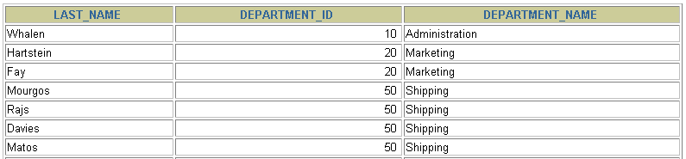
Using Outer Joins
SELECT e.last_name, e.department_id, d.department_name
FROM employees e, departments d
WHERE e.department_id(+) = d.department_id ;
…
Notes:
Using Outer Joins to Return Records with No Direct Match (continued)
The slide example displays employee last names, department ID’s and department names. The Contracting department does not have any employees. The empty value is shown in the output shown.
Outer Join Restrictions
The outer join operator can appear on only one side of the expression—the side that has information missing. It returns those rows from one table that have no direct match in the other table.
A condition involving an outer join cannot use the IN operator or be linked to another condition by the OR operator.
Instructor Note
The UNION operator works around the issue of being able to use an outer join operator on one side of the expression. The ANSI full outer join also allows you to have an outer join on both sides of the expression. It is discussed later in this lesson.
Demo: 4_ojoin.sql
Purpose: To illustrate an outer join.

Slide 143
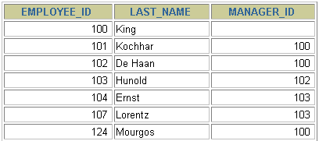
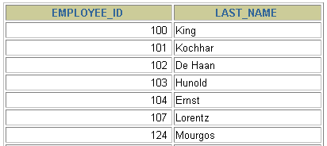
Self Joins
EMPLOYEES (WORKER)
EMPLOYEES (MANAGER)
…
…
MANAGER_ID in the WORKER table is equal to EMPLOYEE_ID in the MANAGER table.
Notes:
Joining a Table to Itself
Sometimes you need to join a table to itself. To find the name of each employee’s manager, you need to join the EMPLOYEES table to itself, or perform a self join. For example, to find the name of Whalen’s manager, you need to:
Find Whalen in the EMPLOYEES table by looking at the LAST_NAME column.
Find the manager number for Whalen by looking at the MANAGER_ID column. Whalen’s manager number is 101.
Find the name of the manager with EMPLOYEE_ID 101 by looking at the LAST_NAME column. Kochhar’s employee number is 101, so Kochhar is Whalen’s manager.
In this process, you look in the table twice. The first time you look in the table to find Whalen in the LAST_NAME column and MANAGER_ID value of 101. The second time you look in the EMPLOYEE_ID column to find 101 and the LAST_NAME column to find Kochhar.
Instructor Note
Show the data from the EMPLOYEES table and point out how each manager is also an employee.

Slide 144
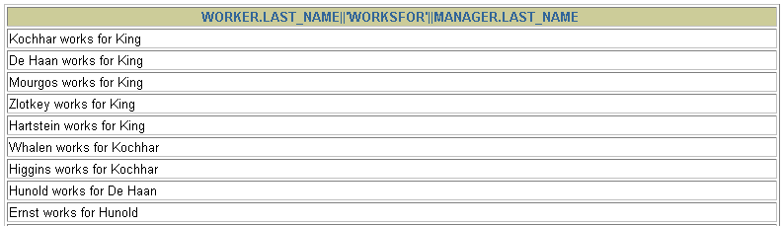
Joining a Table to Itself
SELECT worker.last_name || ' works for '
|| manager.last_name
FROM employees worker, employees manager
WHERE worker.manager_id = manager.employee_id ;
…
Notes:
Joining a Table to Itself (continued)
The slide example joins the EMPLOYEES table to itself. To simulate two tables in the FROM clause, there are two aliases, namely w and m, for the same table, EMPLOYEES.
In this example, the WHERE clause contains the join that means “where a worker’s manager number matches the employee number for the manager.”
Instructor Note
Point out the following to the students:
The column heading in the result of the query on the slide seems meaningless. A meaningful column alias should have been used instead.
There are only 19 rows in the output, but there are 20 rows in the EMPLOYEES table. This occurs because employee King, who is the president, does not have a manager.

Slide 145

Creating Cross Joins
The CROSS JOIN clause produces the cross-product of two tables.
This is the same as a Cartesian product between the two tables.
SELECT last_name, department_name
FROM employees
CROSS JOIN departments ;
…
Notes:
Creating Cross Joins
The example on the slide gives the same results as the following:
SELECT last_name, department_name
FROM employees, departments;
…

Slide 146
INNER Versus OUTER Joins
In SQL: 1999, the join of two tables returning only matched rows is an inner join.
A join between two tables that returns the results of the inner join as well as unmatched rows left (or right) tables is a left (or right) outer join.
A join between two tables that returns the results of an inner join as well as the results of a left and right join is a full outer join.
Notes:
Joins - Comparing SQL: 1999 to Oracle Syntax

Slide 147


LEFT OUTER JOIN
SELECT e.last_name, e.department_id, d.department_name
FROM employees e
LEFT OUTER JOIN departments d
ON (e.department_id = d.department_id) ;
…
Notes:
Example of LEFT OUTER JOIN
This query retrieves all rows in the EMPLOYEES table, which is the left table even if there is no match in the DEPARTMENTS table.
This query was completed in earlier releases as follows:
SELECT e.last_name, e.department_id, d.department_name
FROM employees e, departments d
WHERE d.department_id (+) = e.department_id;

Slide 148

RIGHT OUTER JOIN
SELECT e.last_name, e.department_id, d.department_name
FROM employees e
RIGHT OUTER JOIN departments d
ON (e.department_id = d.department_id) ;
…
Notes:
Example of RIGHT OUTER JOIN
This query retrieves all rows in the DEPARTMENTS table, which is the right table even if there is no match in the EMPLOYEES table.
This query was completed in earlier releases as follows:
SELECT e.last_name, e.department_id, d.department_name
FROM employees e, departments d
WHERE d.department_id = e.department_id (+);

Slide 149

FULL OUTER JOIN
SELECT e.last_name, e.department_id, d.department_name
FROM employees e
FULL OUTER JOIN departments d
ON (e.department_id = d.department_id) ;
…
Notes:
Example of FULL OUTER JOIN
This query retrieves all rows in the EMPLOYEES table, even if there is no match in the DEPARTMENTS table. It also retrieves all rows in the DEPARTMENTS table, even if there is no match in the EMPLOYEES table.
Instructor Note
It was not possible to complete this in earlier releases using outer joins. However, you could accomplish the same results using the UNION operator.
SELECT e.last_name, e.department_id, d.department_name
FROM employees e, departments d
WHERE e.department_id (+) = d.department_id
UNION
SELECT e.last_name, e.department_id, d.department_name
FROM employees e, departments d
WHERE e.department_id = d.department_id (+);

Slide 150

Additional Conditions
SELECT e.employee_id, e.last_name, e.department_id,
d.department_id, d.location_id
FROM employees e JOIN departments d
ON (e.department_id = d.department_id)
AND e.manager_id = 149 ;
Notes:
Applying Additional Conditions
You can apply additional conditions in the WHERE clause. The example shown performs a join on the EMPLOYEES and DEPARTMENTS tables, and, in addition, displays only employees with a manager ID equal to 149.

Slide 151
Displaying Data
from
Multiple
Tables
Copyright © 2004, Oracle. All rights reserved.

Slide 152
Objectives
After completing this lesson, you should be able to
do
the
•
following:
Write SELECT statements to access data from more than one table using equijoins and non- equijoins
Join a table to itself by using a self-join
•
•
View data that generally does not meet a
condition by using outer joins
Generate a Cartesian product of all rows or more tables
join
•
from
two
Copyright © 2004, Oracle. All rights reserved.

Slide 153





Obtaining
Data
from Multiple Tables
EMPLOYEES
DEPARTMENTS
…
…
Copyright © 2004, Oracle. All rights reserved.

Slide 154
Types of Joins
Joins that are compliant with the SQL:1999
include the following:
standard
•
•
•
•
•
Cross joins
Natural joins
USING clause
Full (or two-sided) outer joins
Arbitrary
join
conditions
for
outer
joins
Copyright © 2004, Oracle. All rights reserved.

Slide 155
Joining
Tables Using SQL:1999 Syntax
Use
a
join
to
query
data
from more
than
one
table:
SELECT table1.column, table2.column
FROM table1
[NATURAL JOIN table2] |
[JOIN table2 USING (column_name)] |
[JOIN table2
ON (table1.column_name = table2.column_name)]|
[LEFT|RIGHT|FULL OUTER JOIN table2
ON (table1.column_name = table2.column_name)]|
[CROSS JOIN table2];
Copyright © 2004, Oracle. All rights reserved.

Slide 156
Creating Natural Joins
•
The NATURAL JOIN clause is based on all columns
in the two tables that have the same name.
•
It selects rows from the two tables that have
values in all matched columns.
If the columns having the same names have
equal
•
different
data
types,
an
error
is
returned.
Copyright © 2004, Oracle. All rights reserved.

Slide 157

Retrieving
Records
with
Natural
Joins
SELECT department_id, department_name,
location_id, city
FROM departments
NATURAL JOIN locations
;
Copyright © 2004, Oracle. All rights reserved.

Slide 158
Creating Joins with the USING Clause
•
If several columns have the same names but the
data types do not match, the
NATURAL JOIN clause
can be modified with the USING clause to specify
the columns that should be used for an equijoin.
Use the USING clause to match only one column
when more than one column matches.
•
•
Do not use a table name or alias in the
columns.
The NATURAL JOIN and USING clauses mutually exclusive.
referenced
•
are
Copyright © 2004, Oracle. All rights reserved.

Slide 159


Joining
Column Names
EMPLOYEES
DEPARTMENTS
…
…
Foreign key
Primary key
Copyright © 2004, Oracle. All rights reserved.

Slide 160

Retrieving
Records
with
the
USING Clause
SELECT employees.employee_id, employees.last_name,
departments.location_id, department_id
FROM employees JOIN departments
USING (department_id)
;
…
Copyright © 2004, Oracle. All rights reserved.

Slide 161
Qualifying Ambiguous
Column Names
•
Use table prefixes to qualify column names
are in multiple tables.
Use table prefixes to improve performance.
Use column aliases to distinguish columns
have identical names but reside in different
that
•
•
that
tables.
•
Do not use aliases on columns that are identified
in the USING clause
and
listed
elsewhere
in
the
SQL
statement.
Copyright © 2004, Oracle.
All rights reserved.

Slide 162
Using Table Aliases
•
•
Use
Use
table
table
aliases
aliases
to
to
simplify queries.
improve
performance.
SELECT e.employee_id, e.last_name,
d.location_id, department_id
FROM employees e JOIN departments d
USING (department_id) ;
Copyright © 2004, Oracle. All rights reserved.

Slide 163
Creating Joins with the ON Clause
•
The join condition for the natural join is basically
an equijoin of all columns with the same name.
Use the ON clause to specify arbitrary conditions
or specify columns to join.
The join condition is separated from other search conditions.
•
•
•
The
ON clause
makes
code
easy
to
understand.
Copyright © 2004, Oracle. All rights reserved.

Slide 164

Retrieving
Records
with
the
ON Clause
SELECT e.employee_id, e.last_name, e.department_id,
d.department_id, d.location_id
FROM employees e JOIN departments d
ON (e.department_id = d.department_id)
;
…
Copyright © 2004, Oracle. All rights reserved.

Slide 165


Self-Joins
Using the ON Clause
EMPLOYEES
(WORKER)
EMPLOYEES
(MANAGER)
…
…
MANAGER_ID
in the WORKER table is
equal to
EMPLOYEE_ID in the MANAGER table.
Copyright © 2004, Oracle. All rights reserved.

Slide 166

Self-Joins
Using
the
ON Clause
SELECT e.last_name emp, m.last_name mgr
FROM employees e JOIN employees m
ON (e.manager_id = m.employee_id);
…
Copyright © 2004, Oracle. All rights reserved.

Slide 167

Applying
Additional
Conditions
to
a
Join
SELECT e.employee_id, e.last_name, e.department_id,
d.department_id, d.location_id
FROM employees e JOIN departments d
ON (e.department_id = d.department_id)
AND e.manager_id = 149
;
Copyright © 2004, Oracle. All rights reserved.

Slide 168

Creating
Three-Way Joins
ON Clause
with
the
SELECT employee_id, city, department_name
FROM employees e
JOIN departments d
ON d.department_id = e.department_id
JOIN locations l
ON d.location_id = l.location_id;
…
Copyright © 2004, Oracle. All rights reserved.

Slide 169


Non-Equijoins
EMPLOYEES
JOB_GRADES
Salary in the EMPLOYEES
table must be between
lowest salary and highest
salary in the JOB_GRADES
table.
…
Copyright © 2004, Oracle. All rights reserved.

Slide 170

Retrieving Records
with
Non-Equijoins
SELECT e.last_name, e.salary, j.grade_level
FROM employees e JOIN job_grades j
ON e.salary
BETWEEN j.lowest_sal AND j.highest_sal;
…
Copyright © 2004, Oracle. All rights reserved.

Slide 171


Outer
Joins
DEPARTMENTS
EMPLOYEES
…
There are no
employees in
department 190.
Copyright © 2004, Oracle. All rights reserved.

Slide 172
INNER Versus OUTER Joins
•
In SQL:1999, the join of two tables returning only
matched rows is called an inner join.
A join between two tables that returns the results of the inner join as well as the unmatched rows from the left (or right) tables is called a left (or right) outer join.
A join between two tables that returns the results
•
•
of an inner join as well as the
right join is a full outer join.
results
of
a
left
and
Copyright © 2004, Oracle. All rights reserved.

Slide 173


LEFT
OUTER
JOIN
SELECT e.last_name, e.department_id, d.department_name
FROM employees e LEFT OUTER JOIN departments d
ON (e.department_id = d.department_id) ;
…
Copyright © 2004, Oracle. All rights reserved.

Slide 174


RIGHT
OUTER
JOIN
SELECT e.last_name, e.department_id, d.department_name
FROM employees e RIGHT OUTER JOIN departments d
ON (e.department_id = d.department_id) ;
…
Copyright © 2004, Oracle. All rights reserved.

Slide 175


FULL
OUTER
JOIN
SELECT e.last_name, d.department_id, d.department_name
FROM employees e FULL OUTER JOIN departments d
ON (e.department_id = d.department_id) ;
…
Copyright © 2004, Oracle. All rights reserved.

Slide 176
Cartesian Products
•
A Cartesian product is formed when:
–
–
–
A join condition is omitted
A join condition is invalid
All rows in the first
second table
avoid a Cartesian
table are joined to
all rows
in
the
•
To
product,
always
include
a
valid
join
condition.
Copyright © 2004, Oracle.
All rights reserved.

Slide 177



Generating
a
Cartesian Product
EMPLOYEES
(20
rows)
DEPARTMENTS
(8
rows)
…
Cartesian
product:
20 x 8 = 160 rows
…
Copyright © 2004, Oracle.
All rights reserved.

Slide 178

Creating Cross Joins
•
The CROSS JOIN clause produces the cross-
product of two tables.
This is also called
•
a
Cartesian
product
between
the
two
tables.
SELECT last_name, department_name
FROM employees
CROSS JOIN departments ;
…
Copyright © 2004, Oracle.
All rights reserved.

Slide 179
Summary
In this lesson, you should have learned how to use
joins to display data
from
multiple
tables
by
using:
•
•
•
•
•
•
•
Equijoins
Non-equijoins
Outer joins
Self-joins
Cross joins
Natural joins
Full (or two-sided)
outer joins
Copyright © 2004, Oracle. All rights reserved.

Slide 180
Practice 5: Overview
This practice covers the following topics:
•
•
•
Joining tables using an equijoin
Performing outer and
self-joins
Adding
conditions
Copyright © 2004, Oracle.
All rights reserved.

Slide 181
Using
Subqueries
to
Solve
Queries
Copyright © 2004, Oracle. All rights reserved.

Slide 182
Objectives
After completing this lesson, you should
be able to do
the
•
•
following:
Define subqueries
Describe the types of problems that subqueries can solve
List the types of subqueries
•
•
Write
single-row
and
multiple-row
subqueries
Copyright © 2004, Oracle. All rights reserved.

Slide 183



Using a Subquery
to Solve a Problem
Who
has
a
salary
greater
than
Abel’s?
Main query:
Which employees have salaries greater than Abel’s salary?
Subquery:
What is Abel’s salary?
Copyright © 2004, Oracle. All rights reserved.

Slide 184
Subquery
Syntax
SELECT select_list
FROM table
WHERE expr operator
(SELECT select_list
FROM table);
•
The subquery (inner query) executes
the main query (outer query).
once before
•
The result
query.
of
the
subquery
is
used
by
the
main
Copyright © 2004, Oracle. All rights reserved.

Slide 185

Using a
Subquery
SELECT last_name
WHERE salary >
(SELECT salary
FROM employees
WHERE last_name = 'Abel');
FROM
employees
11000
Copyright © 2004, Oracle.
All rights reserved.

Slide 186
Guidelines for Using Subqueries
•
•
Enclose subqueries in parentheses.
Place subqueries on the right side of the comparison condition.
•
The ORDER
BY clause in the subquery is not
needed unless you are performing Top-N analysis.
Use single-row operators with single-row
•
subqueries, and use multiple-row
multiple-row subqueries.
operators
with
Copyright © 2004, Oracle.
All rights reserved.

Slide 187
Types of
Subqueries
•
Single-row subquery
Main query
returns
Subquery
ST_CLERK
•
Multiple-row
subquery
Main query
returns
Subquery
ST_CLERK
SA_MAN
Copyright © 2004, Oracle.
All rights reserved.

Slide 188
Single-Row Subqueries
•
•
Return only one row
Use
single-row
comparison
operators
Operator
Meaning
=
Equal to
>
Greater than
>=
Greater than or equal to
<
Less than
<=
Less than or equal to
<>
Not equal to
Copyright © 2004, Oracle. All rights reserved.

Slide 189

Executing
Single-Row Subqueries
SELECT last_name, job_id, salary
FROM employees
(SELECT job_id
FROM employees
WHERE employee_id = 141)
AND salary > ₂₆₀₀
(SELECT salary
FROM employees
WHERE employee_id = 143);
WHERE
job_id
=
ST_CLERK
Copyright © 2004, Oracle. All rights reserved.

Slide 190
Using
Group
Functions
in
a
Subquery
SELECT last_name, FROM employees WHERE salary =
job_id, salary
₂₅₀₀
(SELECT MIN(salary)
FROM employees);
Copyright © 2004, Oracle. All rights reserved.

Slide 191
The HAVING Clause with Subqueries
•
•
The Oracle server executes subqueries first.
The Oracle server returns
results
into
the
HAVING
clause
of
the
main query.
SELECT department_id, MIN(salary)
FROM employees
GROUP BY department_id ₂₅₀₀
(SELECT MIN(salary)
FROM employees
WHERE department_id = 50);
HAVING MIN(salary)
>
Copyright © 2004, Oracle.
All rights reserved.

Slide 192
What
Is
Wrong
with
This
Statement?
SELECT employee_id, last_name
FROM employees
WHERE salary =
(SELECT MIN(salary)
FROM employees
GROUP BY department_id);
ERROR at line 4:
ORA-01427: single-row subquery returns more than
one row
Single-row operator with multiple-row subquery
Copyright © 2004, Oracle. All rights reserved.

Slide 193
Will
This
Statement
Return
Rows?
SELECT last_name, job_id
FROM employees
WHERE job_id =
(SELECT job_id
FROM employees
WHERE last_name = 'Haas');
no rows selected
Subquery returns
no values.
Copyright © 2004, Oracle. All rights reserved.

Slide 194
Multiple-Row Subqueries
•
•
Return more than one row
Use
multiple-row
comparison
operators
Operator
Meaning
IN
Equal to any member in the list
ANY
Compare value to each value returned by the
subquery
ALL
Compare value to every value returned by
the subquery
Copyright © 2004, Oracle. All rights reserved.

Slide 195

Using the ANY Operator
in
Multiple-Row
Subqueries
SELECT employee_id, last_name, job_id, salary
FROM employees 9000, 6000, 4200
WHERE salary < ANY
(SELECT salary
FROM employees
WHERE job_id = 'IT_PROG')
AND job_id <> 'IT_PROG';
…
Copyright © 2004, Oracle. All rights reserved.

Slide 196

Using the ALL Operator
in
Multiple-Row
Subqueries
SELECT employee_id, last_name, job_id, salary
FROM employees 9000, 6000, 4200
WHERE salary < ALL
(SELECT salary
FROM employees
WHERE job_id = 'IT_PROG')
AND job_id <> 'IT_PROG';
Copyright © 2004, Oracle. All rights reserved.

Slide 197
Null
Values
in a
Subquery
SELECT emp.last_name
FROM employees emp
WHERE emp.employee_id NOT IN
(SELECT mgr.manager_id
FROM employees mgr);
no rows selected
Copyright © 2004, Oracle. All rights reserved.

Slide 198
Summary
In
•
this lesson, you should have learned how to:
Identify when a subquery can help solve a question
•
Write subqueries
when
a query
is
based
on
unknown
values
SELECT select_list
FROM table
WHERE expr operator
(SELECT select_list
FROM table);
Copyright © 2004, Oracle.
All rights reserved.

Slide 199
Practice 6: Overview
This practice covers the following topics:
•
Creating subqueries to query values based
unknown criteria
on
•
Using subqueries to find out which
values
exist
in
one
set
of
data
and
not
in
another
Copyright © 2004, Oracle. All rights reserved.

Slide 200
Using
the
Set
Operators
Copyright © 2004, Oracle.
All rights reserved.

Slide 201
Objectives
After completing this lesson, you should
be able to
do
the
•
•
following:
Describe set operators
Use a set operator to combine multiple into a single query
queries
•
Control
the
order
of
rows
returned
Copyright © 2004, Oracle.
All rights reserved.

Slide 202
Set Operators
A
B
A
B
UNION/UNION
ALL
A
B
INTERSECT
A
B
MINUS
Copyright © 2004, Oracle.
All rights reserved.

Slide 203
Tables Used in This Lesson
The
•
tables used in this lesson are:
EMPLOYEES: Provides details regarding all current employees
JOB_HISTORY: Records the details of the start date and end date of the former job, and the job
•
identification number and
department
when
an
employee
switches
jobs
Copyright © 2004, Oracle.
All rights reserved.

Slide 204
UNION
Operator
A
B
The UNION operator
returns results
from both
queries after eliminating duplications.
Copyright © 2004, Oracle. All rights reserved.

Slide 205

Using the
UNION Operator
Display the current and
previous job details of
all
employees.
Display
each
employee
only
once.
SELECT employee_id, job_id
FROM employees
UNION
SELECT employee_id, job_id
FROM job_history;
…
…
Copyright © 2004, Oracle. All rights reserved.

Slide 206
UNION
ALL
Operator
A
B
The UNION ALL operator
returns results
from both
queries, including all duplications.
Copyright © 2004, Oracle. All rights reserved.

Slide 207


Using the UNION ALL Operator
Display the current
employees.
and
previous
departments
of
all
SELECT employee_id, job_id, department_id
FROM employees
UNION ALL
SELECT employee_id, job_id, department_id
FROM job_history
ORDER BY employee_id;
…
…
Copyright © 2004, Oracle. All rights reserved.

Slide 208
INTERSECT
Operator
A
B
The INTERSECT
operator returns
rows
that are
common to both queries.
Copyright © 2004, Oracle. All rights reserved.

Slide 209

Using the INTERSECT Operator
Display the employee IDs and job IDs of those
employees who currently have a job title that is the same as their job title when they were initially hired
(that is, they changed jobs
but
have
now
gone
back
to
doing
their
original
job).
SELECT employee_id, job_id
FROM employees
INTERSECT
SELECT employee_id, job_id
FROM job_history;
Copyright © 2004, Oracle.
All rights reserved.

Slide 210
MINUS
Operator
A
B
The MINUS operator
returns rows in
the first query
that are not present in the second query.
Copyright © 2004, Oracle. All rights reserved.

Slide 211


MINUS Operator
Display the employee IDs of
those employees
who
have not
changed
their
jobs
even
once.
SELECT employee_id,job_id
FROM employees
MINUS
SELECT employee_id,job_id
FROM job_history;
…
Copyright © 2004, Oracle. All rights reserved.

Slide 212
Set Operator Guidelines
•
The expressions in the SELECT lists must match in
number and data type.
Parentheses can be used to alter the sequence of execution.
The ORDER BY clause:
•
•
–
–
Can appear only at the very end of the statement
Will accept the column name, aliases from the
first
SELECT statement, or the positional
notation
Copyright © 2004, Oracle. All rights reserved.

Slide 213
The Oracle Server and Set Operators
•
Duplicate rows are automatically eliminated
except in UNION ALL.
Column names from the first query appear in the result.
•
•
The output is sorted in
ascending
order
by
default
except
in
UNION ALL.
Copyright © 2004, Oracle.
All rights reserved.

Slide 214


Matching the SELECT Statements
Using the UNION operator, display the department
ID,
location,
and
hire
date
for
all
employees.
SELECT department_id, TO_NUMBER(null)
location, hire_date
FROM employees
UNION
SELECT department_id, location_id, TO_DATE(null)
FROM departments;
…
Copyright © 2004, Oracle. All rights reserved.

Slide 215

Matching the SELECT
Example
Statement:
Using the UNION operator, display
the
employee
ID,
job
ID,
and
salary
of
all
employees.
SELECT employee_id, job_id,salary
FROM employees
UNION
SELECT employee_id, job_id,0
FROM job_history;
…
Copyright © 2004, Oracle. All rights reserved.

Slide 216

Controlling the Order
of Rows
Produce an
operators.
English
sentence
using
two
UNION
COLUMN a_dummy NOPRINT
SELECT 'sing' AS "My dream", 3 a_dummy
FROM dual
UNION
SELECT 'I''d like to teach', 1 a_dummy
FROM dual
UNION
SELECT 'the world to', 2 a_dummy
FROM dual
ORDER BY a_dummy;
Copyright © 2004, Oracle.
All rights reserved.

Slide 217
Summary
In
•
•
this lesson, you should have learned how to:
Use
Use
UNION
UNION
to return all distinct rows
ALL to return all rows, including
duplicates
Use INTERSECT to return all rows that are shared by both queries
Use MINUS to return all distinct rows that are
•
•
selected by the first query but not by
Use ORDER BY only at the very end of statement
the
the
second
•
Copyright © 2004, Oracle. All rights reserved.

Slide 218
Practice 7: Overview
In this practice, you use the set operators
reports:
to
create
•
•
•
Using
Using
Using
the
the the
UNION operator
INTERSECTION operator
MINUS operator
Copyright © 2004, Oracle. All rights reserved.

Slide 219
Manipulating
Data
Copyright © 2004, Oracle. All rights reserved.

Slide 220
Objectives
After completing this lesson, you should be able to do
the
•
following:
Describe each data manipulation statement
Insert rows into a table Update rows in a table Delete rows from a table
language
(DML)
•
•
•
•
Control
transactions
Copyright © 2004, Oracle.
All rights reserved.

Slide 221
Data Manipulation Language
•
A DML statement is executed when you:
–
–
–
Add new rows to a table
Modify existing rows in a table
Remove existing rows from a table
•
A transaction consists
of a collection of DML
statements
that
form
a
logical
unit
of
work.
Copyright © 2004, Oracle. All rights reserved.

Slide 222

Adding
a
New
Row
to
a
Table
New row
DEPARTMENTS
Insert new row into the
DEPARTMENTS table
Copyright © 2004, Oracle. All rights reserved.

Slide 223
INSERT Statement Syntax
•
Add new rows to a table by using the INSERT
statement:
INSERT INTO table [(column [, column...])]
VALUES (value [, value...]);
•
With this
time.
syntax,
only
one
row
is
inserted
at
a
Copyright © 2004, Oracle. All rights reserved.

Slide 224
Inserting New Rows
•
Insert a new row containing values for each
column.
•
List values
the table.
Optionally,
in the default order of the columns in
•
list the columns in the INSERT clause.
INSERT INTO departments(department_id,
department_name, manager_id, location_id)
VALUES (70, 'Public Relations', 100, 1700);
1 row created.
•
Enclose character and date values in single
quotation marks.
Copyright © 2004, Oracle. All rights reserved.

Slide 225
Inserting Rows with Null Values
•
Implicit method:
column list.
Omit the column
from the
INSERT INTO departments (department_id,
department_name )
VALUES (30, 'Purchasing');
1 row created.
•
Explicit
VALUES
method:
clause.
Specify
the
NULL
keyword
in
the
INSERT INTO departments
VALUES (100, 'Finance', NULL, NULL);
1 row created.
Copyright © 2004, Oracle.
All rights reserved.

Slide 226
Inserting Special
Values
The SYSDATE function
time.
records
the
current
date
and
INSERT INTO employees (employee_id,
first_name, last_name,
email, phone_number,
hire_date, job_id, salary,
commission_pct, manager_id,
department_id)
VALUES (113,
'Louis', 'Popp',
'LPOPP', '515.124.4567',
SYSDATE, 'AC_ACCOUNT', 6900,
NULL, 205, 100);
1 row created.
Copyright © 2004, Oracle. All rights reserved.

Slide 227
Inserting Specific
Date
Values
•
Add
a
new
employee.
INSERT INTO employees
VALUES (114,
'Den', 'Raphealy',
'DRAPHEAL', '515.127.4561',
TO_DATE('FEB 3, 1999', 'MON DD, YYYY'),
'AC_ACCOUNT', 11000, NULL, 100, 30);
1 row created.
•
Verify
your
addition.
Copyright © 2004, Oracle.
All rights reserved.

Slide 228
Copying Rows
from Another Table
•
Write your
INSERT statement with
a
subquery:
INSERT INTO sales_reps(id, name, salary, commission_pct)
SELECT employee_id, last_name, salary, commission_pct
FROM employees
WHERE job_id LIKE '%REP%';
4 rows created.
•
•
Do not use the VALUES clause.
Match the number of columns in clause to those in the subquery.
the
INSERT
Copyright © 2004, Oracle. All rights reserved.

Slide 229


Changing
Data
in
a
Table
EMPLOYEES
Update
rows
in
the
EMPLOYEES
table:
Copyright © 2004, Oracle. All rights reserved.

Slide 230
UPDATE Statement Syntax
•
Modify existing rows with the UPDATE statement:
UPDATE table
SET column = value [, column = value, ...]
[WHERE condition];
•
Update
more
than
one
row
at
a
time
(if
required).
Copyright © 2004, Oracle. All rights reserved.

Slide 231
Updating Rows in a Table
•
Specific row or rows are modified if you
the WHERE clause:
specify
UPDATE employees
SET department_id = 70
WHERE employee_id = 113;
1 row updated.
•
All rows in the table
WHERE clause:
are
modified
if
you
omit
the
UPDATE copy_emp
SET department_id = 110;
22 rows updated.
Copyright © 2004, Oracle.
All rights reserved.

Slide 232
Updating Two Columns with a
Subquery
Update employee
114’s
job
and
salary
to
match
that
of
employee
205.
UPDATE employees
SET job_id = (SELECT job_id
FROM employees
WHERE employee_id = 205),
salary = (SELECT salary
FROM employees
WHERE employee_id = 205)
WHERE employee_id = 114;
1 row updated.
Copyright © 2004, Oracle. All rights reserved.

Slide 233
Updating Rows Based
on Another Table
Use subqueries in UPDATE statements to update
rows
in
a
table
based
on
values
from
another
table:
UPDATE copy_emp
SET department_id = (SELECT department_id
FROM employees
WHERE employee_id = 100)
WHERE job_id = (SELECT job_id
FROM employees
WHERE employee_id = 200);
1 row updated.
Copyright © 2004, Oracle. All rights reserved.

Slide 234


Removing
a
Row
from
a
Table
DEPARTMENTS
Delete
a
row
from
the
DEPARTMENTS table:
Copyright © 2004, Oracle. All rights reserved.

Slide 235
DELETE Statement
You can remove existing
rows
from
a
table
by
using
the
DELETE statement:
DELETE [FROM] table
[WHERE condition];
Copyright © 2004, Oracle.
All rights reserved.

Slide 236
Deleting Rows from a Table
•
Specific
clause:
rows are deleted if you
specify the
WHERE
DELETE FROM departments
WHERE department_name = 'Finance';
1 row deleted.
•
All rows
in the
table
are
deleted
if
you
omit
the
WHERE clause:
DELETE FROM copy_emp;
22 rows deleted.
Copyright © 2004, Oracle.
All rights reserved.

Slide 237
Deleting Rows Based
on Another Table
Use subqueries in DELETE statements to remove
rows
from
a
table
based
on
values
from
another
table:
DELETE FROM employees
WHERE department_id =
(SELECT department_id
FROM departments
WHERE department_name
LIKE '%Public%');
1 row deleted.
Copyright © 2004, Oracle. All rights reserved.

Slide 238
TRUNCATE Statement
•
Removes all rows from a table, leaving the table
empty and the table structure intact
Is a data definition language (DDL) statement
•
rather than
undone
Syntax:
a
DML
statement;
cannot
easily
be
•
TRUNCATE TABLE table_name;
•
Example:
TRUNCATE TABLE copy_emp;
Copyright © 2004, Oracle. All rights reserved.

Slide 239
Using
a
Subquery
in
an
INSERT Statement
INSERT INTO
(SELECT employee_id, last_name,
email, hire_date, job_id, salary,
department_id
FROM employees
WHERE department_id = 50)
VALUES (99999, 'Taylor', 'DTAYLOR',
TO_DATE('07-JUN-99', 'DD-MON-RR'),
'ST_CLERK', 5000, 50);
1 row created.
Copyright © 2004, Oracle. All rights reserved.

Slide 240

Using a Subquery
in
an
INSERT Statement
Verify
the
results:
SELECT employee_id, last_name, email, hire_date,
job_id, salary, department_id
FROM employees
WHERE department_id = 50;
Copyright © 2004, Oracle.
All rights reserved.

Slide 241
Database Transactions
A database transaction consists of one of the
following:
•
DML statements that constitute one consistent
change to the data
•
•
One
One
DDL
data
statement
control
language
(DCL)
statement
Copyright © 2004, Oracle. All rights reserved.

Slide 242
Database Transactions
•
Begin when the first DML SQL statement
executed.
End with one of the following events:
is
•
–
–
A
A
COMMIT or ROLLBACK statement is issued.
DDL or DCL statement executes
(automatic
commit).
–
–
The
The
user exits iSQL*Plus.
system crashes.
Copyright © 2004, Oracle.
All rights reserved.

Slide 243
Advantages of COMMIT
and ROLLBACK Statements
With COMMIT and ROLLBACK statements, you can:
•
•
Ensure data consistency
Preview data changes before making permanent
changes
•
Group
logically
related
operations
Copyright © 2004, Oracle. All rights reserved.

Slide 244
Controlling
Transactions
Time
COMMIT
Transaction
DELETE
SAVEPOINT A
INSERT
UPDATE
SAVEPOINT B
INSERT
ROLLBACK
to SAVEPOINT
ROLLBACK
to SAVEPOINT
ROLLBACK
B
A
Copyright © 2004, Oracle.
All rights reserved.

Slide 245
Rolling Back Changes to a Marker
•
Create a marker in a current transaction by using
the SAVEPOINT statement.
•
Roll back to that marker by
using
the
ROLLBACK
TO
SAVEPOINT statement.
UPDATE...
SAVEPOINT update_done;
Savepoint created.
INSERT...
ROLLBACK TO update_done;
Rollback complete.
Copyright © 2004, Oracle. All rights reserved.

Slide 246
Implicit Transaction Processing
•
An automatic commit occurs
circumstances:
under the following
–
–
–
DDL statement is issued
DCL statement is issued
Normal exit from iSQL*Plus,
without explicitly
issuing COMMIT or ROLLBACK statements
automatic rollback occurs under an abnormal
•
An
termination of
iSQL*Plus or
a
system
failure.
Copyright © 2004, Oracle. All rights reserved.

Slide 247
State of the Data
Before COMMIT or ROLLBACK
•
•
The previous state of the data can be recovered.
The current user can review the results of the DML
operations by using the SELECT statement.
Other users cannot view the results of the DML
statements by the current user.
•
•
The affected rows are locked; other users
cannot
change
the
data
in
the
affected
rows.
Copyright © 2004, Oracle. All rights reserved.

Slide 248
State of the Data After COMMIT
•
Data changes are made permanent in the
database.
The previous state of the data is permanently
All users can view the results.
•
•
•
lost.
Locks on the affected rows are released; those
rows are available
for other
erased.
users
to
manipulate.
•
All
savepoints
are
Copyright © 2004, Oracle. All rights reserved.

Slide 249
Committing
Data
•
Make
the
changes:
DELETE FROM employees
WHERE employee_id = 99999;
1 row deleted.
INSERT INTO departments
VALUES (290, 'Corporate Tax', NULL, 1700);
1 row created.
•
Commit
the changes:
COMMIT;
Commit complete.
Copyright © 2004, Oracle.
All rights reserved.

Slide 250
State of the Data After ROLLBACK
Discard all pending changes by using the ROLLBACK
statement:
•
•
•
Data changes are undone.
Previous state of the data is restored.
Locks
on
the
affected
rows
are
released.
DELETE FROM copy_emp;
22 rows deleted.
ROLLBACK ;
Rollback complete.
Copyright © 2004, Oracle. All rights reserved.

Slide 251
State
of
the
Data
After
ROLLBACK
DELETE FROM test;
25,000 rows deleted.
ROLLBACK;
Rollback complete.
DELETE FROM test WHERE id = 100;
1 row deleted.
SELECT * FROM test WHERE id = 100;
No rows selected.
COMMIT;
Commit complete.
Copyright © 2004, Oracle. All rights reserved.

Slide 252
Statement-Level Rollback
•
If a single DML statement fails during execution,
only that statement is rolled back.
The Oracle server implements an implicit savepoint.
All other changes are retained.
The user should terminate transactions explicitly
•
•
•
by
executing
a
COMMIT or
ROLLBACK statement.
Copyright © 2004, Oracle. All rights reserved.

Slide 253
Read Consistency
•
Read consistency guarantees a consistent view of
the data at all times.
Changes made by one user do not conflict with changes made by another user.
•
•
Read consistency ensures that on
the
same
data:
–
–
Readers do not wait for writers
Writers
do
not
wait
for
readers
Copyright © 2004, Oracle. All rights reserved.

Slide 254


Implementation of Read
Consistency
User
A
Data blocks
Undo segments
UPDATE
SET
WHERE
employees
salary = 7000
last_name = 'Grant';
Changed and
consistent ^{data} change
(“old” data)
SELECT
*
Read-
image
FROM userA.employees;
unchanged
Before
User
B
Copyright © 2004, Oracle.
All rights reserved.

Slide 255
Summary
In this lesson, you should
have
learned
how
to
use
the
following
statements:
Function
Description
INSERT
Adds a new row to the table
UPDATE
Modifies existing rows in the table
DELETE
Removes existing rows from the table
COMMIT
Makes all pending changes permanent
SAVEPOINT
Is used to roll back to the savepoint marker
ROLLBACK
Discards all pending data changes
Copyright © 2004, Oracle.
All rights reserved.

Slide 256
Practice 8: Overview
This practice covers the following topics:
•
•
•
Inserting rows into the tables
Updating and deleting rows
in
the
table
Controlling
transactions
Copyright © 2004, Oracle.
All rights reserved.

Slide 257
Using
Create
DDL Statements
to
and
Manage
Tables
Copyright © 2004, Oracle. All rights reserved.

Slide 258
Objectives
After completing this lesson, you should be
able to do
the
•
•
•
•
•
following:
Categorize the main database objects
Review the table structure
List the data types that are available for
Create a simple table
columns
Understand how constraints are created
time of table creation
Describe how schema objects work
at
the
•
Copyright © 2004, Oracle. All rights reserved.

Slide 259
Database
Objects
Object
Description
Table
Basic unit of storage; composed of rows
View
Logically represents subsets of data from one or more tables
Sequence
Generates numeric values
Index
Improves the performance of some queries
Synonym
Gives alternative names to objects
Copyright © 2004, Oracle. All rights reserved.

Slide 260
Naming Rules
Table names and column names:
•
•
•
•
Must
Must
Must
Must
begin with a letter
be 1–30 characters long contain only A–Z, a–z, 0–9,
_, $, and #
not duplicate the name of another object
owned by the same user
•
Must
not
be an
Oracle
server
reserved
word
Copyright © 2004, Oracle. All rights reserved.

Slide 261

CREATE
TABLE Statement
•
You must have:
–
–
CREATE TABLE
A storage area
privilege
CREATE TABLE [schema.]table
(column datatype [DEFAULT expr][, ...]);
•
You specify:
–
–
Table name
Column
name,
column data
type, and
column
size
Copyright © 2004, Oracle. All rights reserved.

Slide 262


Referencing Another User’s Tables
•
Tables belonging to other users are not in the
user’s schema.
•
You should use
the
owner’s
name
as
a
prefix
to
those
tables.
USERA
USERB
SELECT *
FROM userB.employees;
SELECT *
FROM userA.employees;
Copyright © 2004, Oracle.
All rights reserved.

Slide 263
DEFAULT Option
•
Specify a default value for a column
insert.
during an
... hire_date DATE DEFAULT SYSDATE, ...
•
Literal values, expressions, or SQL functions are
legal values.
•
Another column’s name or
illegal values.
a pseudocolumn are
•
The default data
type.
type must
match the column data
CREATE TABLE hire_dates
(id NUMBER(8),
hire_date DATE DEFAULT SYSDATE); Table created.
Copyright © 2004, Oracle. All rights reserved.

Slide 264

Creating
Tables
•
Create the table.
CREATE TABLE dept
(deptno NUMBER(2),
dname VARCHAR2(14),
loc VARCHAR2(13),
create_date DATE DEFAULT SYSDATE);
Table created.
•
Confirm
table
creation.
DESCRIBE dept
Copyright © 2004, Oracle.
All rights reserved.

Slide 265
Data
Types
Data Type
Description
VARCHAR2(size)
Variable-length character data
CHAR(size)
Fixed-length character data
NUMBER(p,s)
Variable-length numeric data
DATE
Date and time values
LONG
Variable-length character data (up to 2 GB)
CLOB
Character data (up to 4 GB)
RAW and LONG
RAW
Raw binary data
BLOB
Binary data (up to 4 GB)
BFILE
Binary data stored in an external file (up to 4 GB)
ROWID
A base-64 number system representing the unique address of a row in its table
Copyright © 2004, Oracle. All rights reserved.

Slide 266

Datetime Data Types
You
can
use
several
datetime
data
types:
Data Type
Description
TIMESTAMP
Date with fractional seconds
INTERVAL YEAR TO MONTH
Stored as an interval of years and months
INTERVAL DAY TO SECOND
Stored as an interval of days, hours, minutes, and seconds
Copyright © 2004, Oracle.
All rights reserved.

Slide 267
Datetime Data Types
•
The TIMESTAMP data type is an extension of the
DATE data type.
•
It stores the year, month, and day of the DATE
data
well
type plus hour, minute, and second values
as the fractional second value.
as
•
You
can
optionally
specify
the
time
zone.
TIMESTAMP[(fractional_seconds_precision)]
TIMESTAMP[(fractional_seconds_precision)]
WITH TIME ZONE
TIMESTAMP[(fractional_seconds_precision)]
WITH LOCAL TIME ZONE
Copyright © 2004, Oracle. All rights reserved.

Slide 268
Datetime Data Types
•
The INTERVAL YEAR
period of time using
fields:
TO MONTH data type stores a
the
YEAR and MONTH datetime
INTERVAL YEAR [(year_precision)] TO MONTH
•
The INTERVAL
period of time
DAY
TO
SECOND data type stores
a
in
terms
of
days,
hours,
minutes,
and
seconds:
INTERVAL DAY [(day_precision)]
TO SECOND [(fractional_seconds_precision)]
Copyright © 2004, Oracle.
All rights reserved.

Slide 269

Including Constraints
•
•
Constraints enforce rules at the table level.
Constraints prevent the deletion of a table
are dependencies.
if
there
•
The following constraint
types
are
valid:
–
–
–
–
–
NOT NULL
UNIQUE
PRIMARY KEY
FOREIGN KEY
CHECK
Copyright © 2004, Oracle.
All rights reserved.

Slide 270
Constraint Guidelines
•
You can name a constraint, or the Oracle server
generates a name by using the SYS_Cn format.
Create a constraint at either of the following times:
•
–
–
At the same time as the table is created
After the table has been created
•
•
Define a constraint at the column or table
level.
View
a
constraint
in
the
data
dictionary.
Copyright © 2004, Oracle. All rights reserved.

Slide 271
Defining
Constraints
•
Syntax:
CREATE TABLE [schema.]table
(column datatype [DEFAULT expr]
[column_constraint],
...
[table_constraint][,...]);
•
Column-level
constraint:
column [CONSTRAINT constraint_name] constraint_type,
•
Table-level constraint:
column,...
[CONSTRAINT constraint_name] constraint_type
(column, ...),
Copyright © 2004, Oracle.
All rights reserved.

Slide 272
Defining Constraints
•
Column-level constraint:
CREATE TABLE employees(
employee_id NUMBER(6)
first_name VARCHAR2(20),
...);
CONSTRAINT
emp_emp_id_pk
PRIMARY
KEY,
1
•
Table-level
constraint:
CREATE TABLE employees(
employee_id NUMBER(6),
first_name VARCHAR2(20),
... ₂
CONSTRAINT emp_emp_id_pk
PRIMARY KEY (EMPLOYEE_ID));
job_id
VARCHAR2(10) NOT NULL,
Copyright © 2004, Oracle. All rights reserved.

Slide 273

NOT
NULL Constraint
Ensures
column:
that
null
values
are
not
permitted
for
the
…
NOT NULL constraint
(No row can contain
a null value for this column.)
NOT NULL
constraint
Absence of NOT
constraint
(Any row can contain a null value for this
column.)
NULL
Copyright © 2004, Oracle. All rights reserved.

Slide 274

UNIQUE Constraint
UNIQUE constraint
EMPLOYEES
…
INSERT
INTO
Allowed
Not allowed:
already exists
Copyright © 2004, Oracle.
All rights reserved.

Slide 275
UNIQUE Constraint
Defined
at
either
the
table
level
or
the
column
level:
CREATE TABLE employees(
employee_id NUMBER(6),
last_name VARCHAR2(25) NOT NULL,
email VARCHAR2(25),
salary NUMBER(8,2),
commission_pct NUMBER(2,2),
hire_date DATE NOT NULL,
...
CONSTRAINT emp_email_uk UNIQUE(email));
Copyright © 2004, Oracle. All rights reserved.

Slide 276

PRIMARY
KEY Constraint
DEPARTMENTS
PRIMARY
KEY
…
Not allowed
(null value)
INSERT
INTO
Not allowed
(50 already exists)
Copyright © 2004, Oracle. All rights reserved.

Slide 277

FOREIGN
DEPARTMENTS
KEY
Constraint
PRIMARY KEY
…
EMPLOYEES
FOREIGN KEY
…
INSERT INTO
Not allowed
(9 does not
exist)
Allowed
Copyright © 2004, Oracle. All rights reserved.

Slide 278
FOREIGN
KEY Constraint
Defined
at
either
the
table
level
or
the
column
level:
CREATE TABLE employees(
employee_id NUMBER(6),
last_name VARCHAR2(25) NOT NULL,
email VARCHAR2(25),
salary NUMBER(8,2),
commission_pct NUMBER(2,2),
hire_date DATE NOT NULL,
...
department_id NUMBER(4),
CONSTRAINT emp_dept_fk FOREIGN KEY (department_id)
REFERENCES departments(department_id),
CONSTRAINT emp_email_uk UNIQUE(email));
Copyright © 2004, Oracle. All rights reserved.

Slide 279
FOREIGN
KEY Constraint:
Keywords
•
FOREIGN KEY: Defines the column in
table at the table-constraint level
the child
•
REFERENCES: Identifies the table and column
in the parent table
•
ON
DELETE CASCADE: Deletes the dependent
rows in the child table when a row in the
parent table
is deleted
SET NULL: Converts dependent
•
ON
DELETE
foreign key values to null
Copyright © 2004, Oracle. All rights reserved.

Slide 280
CHECK Constraint
•
•
Defines a condition that each row must satisfy
The following expressions are not allowed:
–
References to CURRVAL, NEXTVAL, LEVEL, and
ROWNUM pseudocolumns
–
Calls to SYSDATE, UID, USER, and
functions
USERENV
–
Queries
that
refer
to
other
values
in
other
rows
..., salary NUMBER(2)
CONSTRAINT emp_salary_min
CHECK (salary > 0),...
Copyright © 2004, Oracle. All rights reserved.

Slide 281
CREATE TABLE:
Example
CREATE TABLE employees
( employee_id NUMBER(6)
CONSTRAINT emp_employee_id PRIMARY KEY
, first_name VARCHAR2(20)
, last_name VARCHAR2(25)
CONSTRAINT emp_last_name_nn NOT NULL
, email VARCHAR2(25)
CONSTRAINT emp_email_nn NOT NULL
CONSTRAINT emp_email_uk UNIQUE
, phone_number VARCHAR2(20)
, hire_date DATE
CONSTRAINT emp_hire_date_nn NOT NULL
, job_id VARCHAR2(10)
CONSTRAINT emp_job_nn NOT NULL
, salary NUMBER(8,2)
CONSTRAINT emp_salary_ck CHECK (salary>0)
, commission_pct NUMBER(2,2)
, manager_id NUMBER(6)
, department_id NUMBER(4)
CONSTRAINT emp_dept_fk REFERENCES
departments (department_id));
Copyright © 2004, Oracle. All rights reserved.

Slide 282
Violating
Constraints
UPDATE employees
SET department_id = 55
WHERE department_id = 110;
UPDATE employees
*
ERROR at line 1:
ORA-02291: integrity constraint (HR.EMP_DEPT_FK)
violated - parent key not found
Department 55 does not exist.
Copyright © 2004, Oracle. All rights reserved.

Slide 283
Violating Constraints
You cannot delete a row that contains a primary
key
that
is
used
as
a
foreign
key
in
another
table.
DELETE FROM departments
WHERE department_id = 60;
DELETE FROM departments
*
ERROR at line 1:
ORA-02292: integrity constraint (HR.EMP_DEPT_FK)
violated - child record found
Copyright © 2004, Oracle. All rights reserved.

Slide 284
Creating a Table
by Using a Subquery
•
Create a table and insert rows
by combining the
the AS subquery
CREATE
option.
TABLE statement and
CREATE TABLE table
[(column, column...)]
AS subquery;
•
Match the number of specified columns to
number of subquery columns.
the
•
Define columns with column names
default values.
and
Copyright © 2004, Oracle. All rights reserved.

Slide 285

Creating
a Table
Subquery
by
Using
a
CREATE TABLE dept80
AS
SELECT employee_id, last_name,
salary*12 ANNSAL,
hire_date
FROM employees
WHERE department_id = 80; Table created.
DESCRIBE dept80
Copyright © 2004, Oracle. All rights reserved.

Slide 286
ALTER
TABLE Statement
Use the ALTER TABLE statement to:
•
•
•
•
Add a new column
Modify an existing column
Define a default
value
for
the
new
column
Drop
a
column
Copyright © 2004, Oracle.
All rights reserved.

Slide 287
Dropping a Table
•
•
•
•
•
All data and structure in the table are deleted.
Any pending transactions are committed.
All indexes are dropped.
All constraints are dropped.
You
cannot roll
back
the
DROP
TABLE statement.
DROP TABLE dept80;
Table dropped.
Copyright © 2004, Oracle. All rights reserved.

Slide 288
Summary
In this lesson, you should have learned how to use the
CREATE
TABLE statement to create a table and include
constraints.
•
•
•
•
•
Categorize the main database objects
Review the table structure
List the data types that are available for columns
Create a simple table
Understand how constraints are created
time of table creation
Describe how schema objects work
at
the
•
Copyright © 2004, Oracle. All rights reserved.

Slide 289
Practice 9: Overview
This practice covers the following
topics:
•
•
Creating new tables
Creating a new table by using
AS syntax
the
CREATE
TABLE
•
•
Verifying that tables
exist
Dropping
tables
Copyright © 2004, Oracle.
All rights reserved.

Slide 290
Creating
Other
Schema
Objects
Copyright © 2004, Oracle. All rights reserved.

Slide 291
Objectives
After completing this lesson, you should
be
able
to
do
the
•
•
•
•
•
following:
Create simple and complex views
Retrieve data from views
Create, maintain, and use sequences
Create
Create
and maintain indexes
private
and
public
synonyms
Copyright © 2004, Oracle.
All rights reserved.

Slide 292
Database
Objects
Object
Description
Table
Basic unit of storage; composed of rows
View
Logically represents subsets of data from one or more tables
Sequence
Generates numeric values
Index
Improves the performance of some queries
Synonym
Gives alternative names to objects
Copyright © 2004, Oracle. All rights reserved.

Slide 293

What
Is
a
View?
EMPLOYEES table
Copyright © 2004, Oracle.
All rights reserved.

Slide 294

Advantages
of
Views
To restrict data access
To make complex queries easy
To provide
independence
To present different views of the same data
data
Copyright © 2004, Oracle.
All rights reserved.

Slide 295
Simple
Views
and Complex
Views
Feature
Simple Views
Complex Views
Number of tables
One
One or more
Contain functions
No
Yes
Contain groups of data
No
Yes
DML operations through a view
Yes
Not always
Copyright © 2004, Oracle. All rights reserved.

Slide 296
Creating a View
•
You embed
statement:
a
subquery
in
the
CREATE
VIEW
CREATE [OR REPLACE] [FORCE|NOFORCE] VIEW view
[(alias[, alias]...)]
AS subquery
[WITH CHECK OPTION [CONSTRAINT constraint]]
[WITH READ ONLY [CONSTRAINT constraint]];
•
The subquery
syntax.
can
contain
complex
SELECT
Copyright © 2004, Oracle. All rights reserved.

Slide 297
Creating a View
•
Create the EMPVU80 view, which
of employees in department 80:
contains
details
CREATE VIEW empvu80
AS SELECT employee_id, last_name, salary
FROM employees
WHERE department_id = 80;
View created.
•
Describe the structure of the view
by
using
the
iSQL*Plus
DESCRIBE command:
DESCRIBE empvu80
Copyright © 2004, Oracle. All rights reserved.

Slide 298
Creating a View
•
Create a view
subquery:
by
using
column
aliases
in
the
CREATE VIEW salvu50
AS SELECT employee_id ID_NUMBER, last_name NAME,
salary*12 ANN_SALARY
FROM employees
WHERE department_id = 50;
View created.
•
Select the columns from this view by the
alias names:
given
Copyright © 2004, Oracle. All rights reserved.

Slide 299

Retrieving
Data
from
a
View
SELECT *
FROM salvu50;
Copyright © 2004, Oracle.
All rights reserved.

Slide 300
Modifying a View
•
Modify the EMPVU80 view by using a CREATE
OR
REPLACE
VIEW clause.
Add
an
alias
for
each
column
name:
CREATE OR REPLACE VIEW empvu80
(id_number, name, sal, department_id)
AS SELECT employee_id, first_name || ' '
|| last_name, salary, department_id
FROM employees
WHERE department_id = 80;
View created.
•
Column aliases
in the CREATE
OR
REPLACE
VIEW
clause are listed in the same order as the columns
in the subquery.
Copyright © 2004, Oracle. All rights reserved.

Slide 301
Creating a Complex View
Create a complex view that contains
group
functions
to
display
values
from
two
tables:
CREATE OR REPLACE VIEW dept_sum_vu
(name, minsal, maxsal, avgsal)
AS SELECT d.department_name, MIN(e.salary),
MAX(e.salary),AVG(e.salary)
FROM employees e JOIN departments d
ON (e.department_id = d.department_id)
GROUP BY d.department_name;
View created.
Copyright © 2004, Oracle. All rights reserved.

Slide 302


Rules for Performing
DML Operations on a View
•
You can usually perform DML operations
on simple views.
You cannot remove a row if the view contains following:
•
the
–
–
–
–
Group functions
A GROUP BY clause
The
The
DISTINCT keyword
pseudocolumn ROWNUM
keyword
Copyright © 2004, Oracle. All rights reserved.

Slide 303
Rules for Performing
DML Operations on a View
You cannot modify data in a view if it contains:
•
•
•
•
•
Group functions
A GROUP
BY clause
The
The
DISTINCT keyword
pseudocolumn ROWNUM keyword
Columns
defined
by
expressions
Copyright © 2004, Oracle. All rights reserved.

Slide 304
Rules for Performing
DML Operations on a View
You cannot add data through a view if the
includes:
view
•
•
•
•
•
•
Group functions
A GROUP
BY clause
The
The
DISTINCT keyword
pseudocolumn ROWNUM keyword
Columns defined by expressions
NOT
NULL columns in the base tables
that are
not
selected by the view
Copyright © 2004, Oracle. All rights reserved.

Slide 305
Using the WITH
CHECK
OPTION Clause
•
You can ensure that DML operations performed on
the
the
view stay in the domain of the
view
by
using
WITH
CHECK
OPTION clause:
CREATE OR REPLACE VIEW empvu20
AS SELECT *
FROM employees
WHERE department_id = 20
WITH CHECK OPTION CONSTRAINT empvu20_ck ;
View created.
•
Any attempt to change the department
number for
any row in the view fails because it violates the
WITH
CHECK
OPTION constraint.
Copyright © 2004, Oracle. All rights reserved.

Slide 306

Denying DML Operations
•
You can ensure that no
DML operations occur by
ONLY option to your view
adding the WITH
definition.
Any attempt to perform
READ
•
a
DML operation on any
row
in
the
view
results
in
an
Oracle
server
error.
Copyright © 2004, Oracle.
All rights reserved.

Slide 307
Denying
DML Operations
CREATE OR REPLACE VIEW empvu10
(employee_number, employee_name, job_title)
AS SELECT employee_id, last_name, job_id
FROM employees
WHERE department_id = 10
WITH READ ONLY ;
View created.
Copyright © 2004, Oracle. All rights reserved.

Slide 308
Removing a View
You can remove a view without losing data because
a
view
is
based
on
underlying
tables
in
the
database.
DROP VIEW view;
DROP VIEW empvu80;
View dropped.
Copyright © 2004, Oracle. All rights reserved.

Slide 309
Practice 10: Overview of Part
1
This practice covers the following topics:
•
•
•
•
•
Creating
Creating
Creating
a
a a
simple view
complex view view with a check
constraint
Attempting to modify
data
in
the
view
Removing
views
Copyright © 2004, Oracle.
All rights reserved.

Slide 310
Sequences
Object
Description
Table
Basic unit of storage; composed of rows
View
Logically represents subsets of data from one or more tables
Sequence
Generates numeric values
Index
Improves the performance of some queries
Synonym
Gives alternative names to objects
Copyright © 2004, Oracle. All rights reserved.

Slide 311

Sequences
A
•
•
•
•
•
sequence:
Can automatically generate unique
Is a sharable object
numbers
Can be used to create a primary key value
Replaces application code
Speeds up the efficiency of accessing sequence
values
when
cached
in
memory
2
4
6
8
10
1
3
5
7
9
Copyright © 2004, Oracle. All rights reserved.

Slide 312
CREATE
SEQUENCE Statement:
Syntax
Define a sequence
automatically:
to
generate
sequential
numbers
CREATE SEQUENCE sequence
[INCREMENT BY n]
[START WITH n]
[{MAXVALUE n | NOMAXVALUE}]
[{MINVALUE n | NOMINVALUE}]
[{CYCLE | NOCYCLE}]
[{CACHE n | NOCACHE}];
Copyright © 2004, Oracle. All rights reserved.

Slide 313
Creating a Sequence
•
Create a sequence named DEPT_DEPTID_SEQ to
be used for the primary key of
table.
the
DEPARTMENTS
•
Do
not
use
the
CYCLE option.
CREATE SEQUENCE dept_deptid_seq
INCREMENT BY 10
START WITH 120
MAXVALUE 9999
NOCACHE
NOCYCLE;
Sequence created.
Copyright © 2004, Oracle. All rights reserved.

Slide 314
NEXTVAL and CURRVAL Pseudocolumns
•
NEXTVAL returns the next available sequence
value. It returns a unique value every time it is referenced, even for different users.
•
•
CURRVAL
NEXTVAL CURRVAL
obtains the current sequence value.
must be issued for
that
sequence
before
contains
a
value.
Copyright © 2004, Oracle. All rights reserved.

Slide 315
Using a Sequence
•
Insert a new department
named
“Support”
in
location
ID 2500:
INSERT INTO departments(department_id,
department_name, location_id)
VALUES (dept_deptid_seq.NEXTVAL,
'Support', 2500);
1 row created.
•
View the current value for
sequence:
the DEPT_DEPTID_SEQ
SELECT dept_deptid_seq.CURRVAL
FROM dual;
Copyright © 2004, Oracle. All rights reserved.

Slide 316
Caching Sequence Values
•
Caching sequence values in memory gives
access to those values.
Gaps in sequence values can occur when:
faster
•
–
–
–
A rollback occurs
The system crashes
A
sequence
is
used
in
another
table
Copyright © 2004, Oracle. All rights reserved.

Slide 317
Modifying a Sequence
Change the increment value, maximum value,
minimum
value, cycle
option,
or
cache
option:
ALTER SEQUENCE dept_deptid_seq
INCREMENT BY 20
MAXVALUE 999999
NOCACHE
NOCYCLE;
Sequence altered.
Copyright © 2004, Oracle.
All rights reserved.

Slide 318
Guidelines for Modifying
a Sequence
•
You must be the owner or have the ALTER
privilege for the sequence.
Only future sequence numbers are affected.
The sequence must be dropped and
re-created to restart the sequence at a different
number.
Some validation is performed.
•
•
•
•
To
remove
a sequence, use the
DROP statement:
DROP SEQUENCE dept_deptid_seq;
Sequence dropped.
Copyright © 2004, Oracle. All rights reserved.

Slide 319
Indexes
Object
Description
Table
Basic unit of storage; composed of rows
View
Logically represents subsets of data from one or more tables
Sequence
Generates numeric values
Index
Improves the performance of some queries
Synonym
Gives alternative names to objects
Copyright © 2004, Oracle. All rights reserved.

Slide 320

Indexes
An
•
•
index:
Is a schema object
Can be used by the Oracle server
to speed up the
retrieval of rows by using a pointer
Can reduce disk I/O by using a rapid path access method to locate data quickly
Is independent of the table that it indexes
•
•
•
Is used and maintained automatically
Oracle server
by
the
Copyright © 2004, Oracle. All rights reserved.

Slide 321


How Are Indexes Created?
•
Automatically: A unique index is created
automatically when you define a PRIMARY UNIQUE constraint in a table definition.
KEY
or
•
Manually: Users can create nonunique indexes
on
columns
to
speed up access to the
rows.
Copyright © 2004, Oracle. All rights reserved.

Slide 322
Creating
an Index
•
Create an index on one
or more columns:
CREATE INDEX index
ON table (column[, column]...);
•
Improve the speed of query access to
the
table:
LAST_NAME column
in
the
EMPLOYEES
CREATE INDEX emp_last_name_idx
ON employees(last_name);
Index created.
Copyright © 2004, Oracle. All rights reserved.

Slide 323








Index
Creation
Guidelines
Create an index when:
A column contains a wide range of values
A column contains a large number of null values
One or more columns are frequently used together in a WHERE
clause or a join condition
The table is large and most queries are expected to retrieve less than 2% to 4% of the rows in the table
Do not create an index when:
The columns are not often used as a condition in the query
The table is small or most queries are expected to retrieve more than 2% to 4% of the rows in the table
The table is updated frequently
The indexed columns are referenced as part of an expression
Copyright © 2004, Oracle. All rights reserved.

Slide 324
Removing an Index
•
Remove an index from
the data dictionary
command:
by
using the DROP
INDEX
DROP INDEX index;
•
Remove the UPPER_LAST_NAME_IDX
the data dictionary:
index from
DROP INDEX emp_last_name_idx;
Index dropped.
•
To drop an index, you must be the owner of the
index or have the DROP
ANY
INDEX privilege.
Copyright © 2004, Oracle. All rights reserved.

Slide 325
Synonyms
Object
Description
Table
Basic unit of storage; composed of rows
View
Logically represents subsets of data from one or more tables
Sequence
Generates numeric values
Index
Improves the performance of some queries
Synonym
Gives alternative names to objects
Copyright © 2004, Oracle. All rights reserved.

Slide 326
Synonyms
Simplify access to objects by creating a synonym
(another name for an object). With synonyms, you can:
•
Create an easier reference to a
by another user
table
that
is
owned
•
Shorten
lengthy
object
names
CREATE [PUBLIC] SYNONYM synonym
FOR object;
Copyright © 2004, Oracle. All rights reserved.

Slide 327
Creating and Removing Synonyms
•
Create a shortened
view:
name
for
the
DEPT_SUM_VU
CREATE SYNONYM d_sum
FOR dept_sum_vu;
Synonym Created.
•
Drop
a
synonym:
DROP SYNONYM d_sum;
Synonym dropped.
Copyright © 2004, Oracle.
All rights reserved.

Slide 328
Summary
In
•
•
this lesson, you should have learned how to:
Create, use, and remove views
Automatically generate sequence numbers by using a sequence generator
Create indexes to improve query retrieval speed
•
•
Use synonyms
objects
to
provide
alternative
names
for
Copyright © 2004, Oracle. All rights reserved.

Slide 329
Practice 10: Overview of Part
2
This practice covers the following
topics:
•
•
•
•
Creating sequences
Using sequences
Creating
Creating
nonunique
synonyms
indexes
Copyright © 2004, Oracle.
All rights reserved.

Slide 330
Managing Objects
with Data
Dictionary
Views
Copyright © 2004, Oracle. All rights reserved.

Slide 331
Objectives
After completing this lesson, you should be able to do
the
•
following:
Use the data dictionary views to research your objects
data
on
•
Query
various
data
dictionary
views
Copyright © 2004, Oracle. All rights reserved.

Slide 332

The
Data Dictionary
Oracle
server
Tables containing
business data:
EMPLOYEES
DEPARTMENTS
LOCATIONS
JOB_HISTORY
...
Data dictionary
views: DICTIONARY
USER_OBJECTS
USER_TABLES
USER_TAB_COLUMNS
...
Copyright © 2004, Oracle. All rights reserved.

Slide 333


Data
Dictionary
Structure
Oracle
server
Consists of:
–
–
Base tables
User-accessible
views
Copyright © 2004, Oracle. All rights reserved.

Slide 334
Data Dictionary
Structure
View
naming
convention:
View Prefix
Purpose
USER
User’s view (what is in your schema;
what you own)
ALL
Expanded user’s view (what you can access)
DBA
Database administrator’s view (what is in everyone’s schemas)
V$
Performance-related data
Copyright © 2004, Oracle.
All rights reserved.

Slide 335

How to Use the Dictionary Views
Start with DICTIONARY. It contains the names and
descriptions
of
the
dictionary
tables
and
views.
DESCRIBE DICTIONARY
SELECT *
FROM dictionary
WHERE table_name = 'USER_OBJECTS';
Copyright © 2004, Oracle.
All rights reserved.

Slide 336
USER_OBJECTS and ALL_OBJECTS Views
USER_OBJECTS:
•
Query USER_OBJECTS to see all of the objects
are owned by you
Is a useful way to obtain a listing of all object
that
•
names and types in your schema, plus
following information:
the
–
–
–
Date created
Date of last modification
Status (valid or invalid)
ALL_OBJECTS:
•
Query ALL_OBJECTS to see
you have access
all objects to which
Copyright © 2004, Oracle. All rights reserved.

Slide 337

USER_OBJECTS View
SELECT object_name, object_type, created, status
FROM user_objects
ORDER BY object_type;
…
Copyright © 2004, Oracle. All rights reserved.

Slide 338


Table
Information
USER_TABLES:
DESCRIBE user_tables
SELECT table_name
FROM user_tables;
…
Copyright © 2004, Oracle. All rights reserved.

Slide 339

Column
Information
USER_TAB_COLUMNS:
DESCRIBE user_tab_columns
…
Copyright © 2004, Oracle.
All rights reserved.

Slide 340

Column
Information
SELECT column_name, data_type, data_length,
data_precision, data_scale, nullable
FROM user_tab_columns
WHERE table_name = 'EMPLOYEES';
Copyright © 2004, Oracle. All rights reserved.

Slide 341

Constraint Information
•
USER_CONSTRAINTS describes the constraint
definitions on your tables.
•
USER_CONS_COLUMNS describes columns
that
are
owned by you
constraints.
and
that
are
specified
in
DESCRIBE user_constraints
…
Copyright © 2004, Oracle.
All rights reserved.

Slide 342

Constraint
Information
SELECT constraint_name, constraint_type,
search_condition, r_constraint_name,
delete_rule, status
FROM user_constraints
WHERE table_name = 'EMPLOYEES';
Copyright © 2004, Oracle. All rights reserved.

Slide 343


Constraint
Information
DESCRIBE user_cons_columns
SELECT constraint_name, column_name
FROM user_cons_columns
WHERE table_name = 'EMPLOYEES';
…
Copyright © 2004, Oracle. All rights reserved.

Slide 344


View
Information
1
DESCRIBE user_views
2
SELECT DISTINCT view_name FROM user_views;
3
SELECT text FROM user_views
WHERE view_name = 'EMP_DETAILS_VIEW';
Copyright © 2004, Oracle. All rights reserved.

Slide 345

Sequence
Information
DESCRIBE user_sequences
Copyright © 2004, Oracle. All rights reserved.

Slide 346

Sequence Information
•
Verify your sequence values in the
USER_SEQUENCES
data
dictionary
table.
SELECT sequence_name, min_value, max_value,
increment_by, last_number
FROM user_sequences;
•
The LAST_NUMBER column displays the next
available sequence number if NOCACHE is
specified.
Copyright © 2004, Oracle. All rights reserved.

Slide 347

Synonym
Information
DESCRIBE user_synonyms
SELECT *
FROM user_synonyms;
Copyright © 2004, Oracle. All rights reserved.

Slide 348
Adding Comments to a Table
•
You can add comments to a table or column
using the COMMENT statement:
by
COMMENT ON TABLE employees
IS 'Employee Information';
Comment created.
•
Comments can be viewed
dictionary views:
through
the
data
–
–
–
–
ALL_COL_COMMENTS
USER_COL_COMMENTS
ALL_TAB_COMMENTS
USER_TAB_COMMENTS
Copyright © 2004, Oracle.
All rights reserved.

Slide 349
Summary
In this lesson, you should have learned how to find
information about your objects
dictionary views:
through
the
following
•
•
•
•
•
•
•
•
•
DICTIONARY
USER_OBJECTS
USER_TABLES
USER_TAB_COLUMNS
USER_CONSTRAINTS
USER_CONS_COLUMNS
USER_VIEWS
USER_SEQUENCES
USER_TAB_SYNONYMS
Copyright © 2004, Oracle.
All rights reserved.

Slide 350
Practice 11: Overview
This practice covers the following topics:
•
Querying the dictionary
column information
views
for
table
and
•
Querying the
information
Querying the
Querying the
information
Querying the information
dictionary
views
for
constraint
•
•
dictionary
dictionary
views
views
for
for
view information
sequence
•
dictionary
views
for
synonym
•
Adding a comment to a table and
querying the
dictionary views for comment information
Copyright © 2004, Oracle. All rights reserved.

Slide 351
Oracle
Join
Syntax
Copyright © 2004, Oracle. All rights reserved.

Slide 352
Objectives
After completing this lesson, you should be able to do
the
•
following:
Write SELECT statements to access data from more than one table using equijoins and non- equijoins
•
Use outer joins to view data that generally
not meet a join condition
does
•
Join
a
table to itself by using
a self-join
Copyright © 2004, Oracle. All rights reserved.

Slide 353
Obtaining
Data
from Multiple Tables
EMPLOYEES
DEPARTMENTS
…
…
Copyright © 2004, Oracle. All rights reserved.

Slide 354
Cartesian Products
•
A Cartesian product is formed when:
–
–
–
A join condition is omitted
A join condition is invalid
All rows in the first table are joined to second table
all rows
in
the
•
To
avoid a Cartesian product, always include
a
valid
join
condition
in
a
WHERE clause.
Copyright © 2004, Oracle. All rights reserved.

Slide 355

Generating
a
Cartesian Product
EMPLOYEES
(20
rows)
DEPARTMENTS
(8
rows)
…
Cartesian
product:
20 x 8 = 160 rows
…
Copyright © 2004, Oracle.
All rights reserved.

Slide 356
Types
of Joins
Oracle-proprietary joins
SQL:1999–compliant
joins
(8i
and earlier releases)
•
•
•
•
Equijoin
Non-equijoin
Outer join
Self-join
•
•
•
•
Cross join
Natural join
Using clause
Full (or two-sided)
outer join
Arbitrary join condition for outer join
•
Copyright © 2004, Oracle.
All rights reserved.

Slide 357
Joining Tables
Using Oracle Syntax
Use a join to query data
from more than one table:
SELECT table1.column, table2.column
FROM table1, table2
WHERE table1.column1 = table2.column2;
•
•
Write the join condition in the WHERE clause.
Prefix the column name with the table name when the same column name appears in more than one table.
Copyright © 2004, Oracle. All rights reserved.

Slide 358
Equijoins
EMPLOYEES
DEPARTMENTS
…
…
Foreign key
Primary key
Copyright © 2004, Oracle. All rights reserved.

Slide 359

Retrieving Records
with Equijoins
SELECT employees.employee_id, employees.last_name,
employees.department_id, departments.department_id,
departments.location_id
FROM employees, departments
WHERE
employees.department_id = departments.department
employees.department_id
=
departments.department_id;
…
Copyright © 2004, Oracle. All rights reserved.

Slide 360


Additional Search Conditions
Using
the
AND Operator
EMPLOYEES
DEPARTMENTS
…
…
Copyright © 2004, Oracle.
All rights reserved.

Slide 361
Qualifying Ambiguous Column Names
•
Use table prefixes to qualify column names that
are in multiple tables.
Use table prefixes to improve performance.
Use column aliases to distinguish columns that
•
•
have
identical
names
but
reside
in
different
tables.
Copyright © 2004, Oracle.
All rights reserved.

Slide 362
Using Table Aliases
•
•
Use
Use
table
table
aliases to simplify queries.
prefixes
to
improve
performance.
SELECT e.employee_id, e.last_name, e.department_id,
d.department_id, d.location_id
FROM employees e , departments d
WHERE e.department_id = d.department_id;
Copyright © 2004, Oracle. All rights reserved.

Slide 363



Joining
More Than
Two
Tables
EMPLOYEES
DEPARTMENTS
LOCATIONS
…
To join n tables together,
you need a minimum of
n–1 a
join conditions. For example, to join three tables,
minimum of two joins is required.
Copyright © 2004, Oracle. All rights reserved.

Slide 364
Non-Equijoins
EMPLOYEES
JOB_GRADES
Salary in the EMPLOYEES
table must be between
lowest salary and highest
salary in the JOB_GRADES
table.
…
Copyright © 2004, Oracle. All rights reserved.

Slide 365
Retrieving Records
with
Non-Equijoins
SELECT e.last_name, e.salary, j.grade_level
FROM employees e, job_grades j
WHERE e.salary
BETWEEN j.lowest_sal AND j.highest_sal;
…
Copyright © 2004, Oracle. All rights reserved.

Slide 366

Outer
Joins
DEPARTMENTS
EMPLOYEES
…
There are no employees in department 190.
Copyright © 2004, Oracle. All rights reserved.

Slide 367
Outer Joins Syntax
•
You use an outer join to see rows that do not
the join condition.
meet
•
The
outer
join
operator
is
the
plus
sign
(+).
SELECT table1.column, table2.column
FROM table1, table2
WHERE table1.column(+) = table2.column;
SELECT table1.column, table2.column
FROM table1, table2
WHERE table1.column = table2.column(+);
Copyright © 2004, Oracle.
All rights reserved.

Slide 368

Using
Outer
Joins
SELECT e.last_name, e.department_id, d.department_name
FROM employees e, departments d
WHERE e.department_id(+) = d.department_id ;
…
Copyright © 2004, Oracle. All rights reserved.

Slide 369
Self-Joins
EMPLOYEES
(WORKER)
EMPLOYEES
(MANAGER)
…
…
MANAGER_ID in the WORKER table is equal to
EMPLOYEE_ID in the MANAGER table.
Copyright © 2004, Oracle. All rights reserved.

Slide 370

Joining
a
Table
to
Itself
SELECT worker.last_name || ' works for '
|| manager.last_name
FROM employees worker, employees manager
WHERE worker.manager_id = manager.employee_id ;
…
Copyright © 2004, Oracle. All rights reserved.

Slide 371
Summary
In this appendix, you should have learned how to use
joins to display data from
multiple tables by using
Oracle-proprietary
syntax
for versions
8i
and
earlier.
Copyright © 2004, Oracle. All rights reserved.

Slide 372
Practice C: Overview
This practice covers writing
queries
to
join
tables
using
Oracle
syntax.
Copyright © 2004, Oracle.
All rights reserved.

Slide 373
Using
SQL*Plus
Copyright © 2004, Oracle. All rights reserved.

Slide 374
Objectives
After completing this appendix, you
should be able
to
do
•
•
•
•
the following:
Log in to SQL*Plus
Edit SQL commands
Format output using SQL*Plus
commands
Interact
with
script
files
Copyright © 2004, Oracle.
All rights reserved.

Slide 375


SQL
and
SQL*Plus Interaction
SQL statements
Server
SQL*Plus
Query results
Buffer
SQL
scripts
Copyright © 2004, Oracle. All rights reserved.

Slide 376
SQL Statements Versus
SQL*Plus
Commands
SQL
SQL*Plus
•
•
•
A language
ANSI-standard
Keywords cannot abbreviated
•
•
•
An environment
Oracle-proprietary
Keywords can be abbreviated
Commands do not allow manipulation
be
•
Statements manipulate data and table
•
of
definitions database
in the
values
in
the
database
SQL
statements
SQL
buffer
SQL*Plus commands
SQL*Plus buffer
Copyright © 2004, Oracle.
All rights reserved.

Slide 377
Overview of SQL*Plus
•
•
•
•
•
Log in to SQL*Plus.
Describe the table structure.
Edit your SQL statement.
Execute SQL from SQL*Plus.
Save SQL statements to files
statements to files.
Execute saved files.
and append
SQL
•
•
Load commands from
file to buffer to edit.
Copyright © 2004, Oracle. All rights reserved.

Slide 378

Logging In to SQL*Plus
•
From
a
Windows
environment:
•
From
a
command line:
sqlplus [username[/password
[@database]]]
Copyright © 2004, Oracle. All rights reserved.

Slide 379
Displaying Table Structure
Use the SQL*Plus DESCRIBE command
to
display
the
structure
of
a
table:
DESC[RIBE] tablename
Copyright © 2004, Oracle.
All rights reserved.

Slide 380
Displaying
Table
Structure
SQL> DESCRIBE departments
Name Null? Type
----------------------- -------- ------------
DEPARTMENT_ID NOT NULL NUMBER(4)
DEPARTMENT_NAME NOT NULL VARCHAR2(30)
MANAGER_ID NUMBER(6)
LOCATION_ID NUMBER(4)
Copyright © 2004, Oracle. All rights reserved.

Slide 381
SQL*Plus Editing
Commands
•
•
•
•
•
•
•
A[PPEND]
C[HANGE]
C[HANGE]
CL[EAR]
DEL
text
/
/
old
text
/
new
/
BUFF[ER]
DEL
DEL
n
m
n
Copyright © 2004, Oracle.
All rights reserved.

Slide 382
SQL*Plus
Editing
Commands
•
•
•
•
•
•
•
•
•
I[NPUT]
I[NPUT]
L[IST]
L[IST]
L[IST]
R[UN]
n
text
n
m
n
n
0
text
text
Copyright © 2004, Oracle.
All rights reserved.

Slide 383
Using
LIST,
n, and
APPEND
SQL> LIST
1 SELECT last_name
2* FROM employees
SQL> 1
1* SELECT last_name
SQL> A , job_id
1* SELECT last_name, job_id
SQL> L
1 SELECT last_name, job_id
2* FROM employees
Copyright © 2004, Oracle. All rights reserved.

Slide 384
Using
the
CHANGE Command
SQL> L
1* SELECT * from employees
SQL> c/employees/departments
1* SELECT * from departments
SQL> L
1* SELECT * from departments
Copyright © 2004, Oracle. All rights reserved.

Slide 385
SQL*Plus
File
Commands
•
•
•
•
•
•
•
SAVE
GET
filename
filename
START
filename
@
filename
EDIT
filename
SPOOL
EXIT
filename
Copyright © 2004, Oracle.
All rights reserved.

Slide 386
Using
the
SAVE and
START Commands
SQL> L
1 SELECT last_name, manager_id, department_id
2* FROM employees
SQL> SAVE my_query
Created file my_query
SQL> START my_query
LAST_NAME MANAGER_ID DEPARTMENT_ID
------------------------- ---------- -------------
King 90
Kochhar 100 90
...
20 rows selected.
Copyright © 2004, Oracle. All rights reserved.

Slide 387
Summary
In this appendix, you should have learned how to
use
SQL*Plus as an environment to
do
the
following:
•
•
•
•
Execute SQL statements
Edit SQL statements
Format output
Interact
with
script
files
Copyright © 2004, Oracle.
All rights reserved.

